Slide 1
Weekly Progress

Slide 2
Apr 7, 2026

Slide 3
Mar 31, 2026

Slide 4
Next Steps
work on research poster(due 31st March)
shift from the voice agent to general omni model optimizing.( Work on the code Hongrui sent)
First understand how GLM work <- search Qwen image
find some models that can generate vision task and text tasks
look at omni models with diffusion components (GLM) understand resource requirements for LLM and diffusion models
Notes:
Thats all for up my update.

Slide 5

General
omni model optimizing

Slide 6
EXPERIMENT OVERVIEW
What does the code do?
Bash Orchestrator
Launches the vLLM model server inside a Singularity container under 4 different GPU memory settings (60-90%), one at a time, then tears it down cleanly before the next run.
Python Stress Tester
Fires 200 text-to-speech requests at the live server with 16 concurrent threads, timing every single response. Aggregates results into throughput and latency metrics.
Result Aggregator
Each run appends its metrics to a shared JSON file. The plotting script reads this and renders the comparison charts summarised in this presentation.

Slide 7
What was varied vs. fixed
🔄 WHAT WAS VARIED
📌 WHAT WAS FIXED
GPU Memory Utilisation
Model
Qwen/Qwen2.5-Omni-7B
60%
70%
80%
90%
GPU
Single GPU (GPU 0)
Tensor Parallel
tp = 1
Each setting ran independently on GPU 0 with a full server restart between runs to ensure a clean VRAM state.
Total Requests
200 per config
Concurrency
16 parallel threads
Client Timeout
600 seconds
Warmup
10 requests

Slide 8
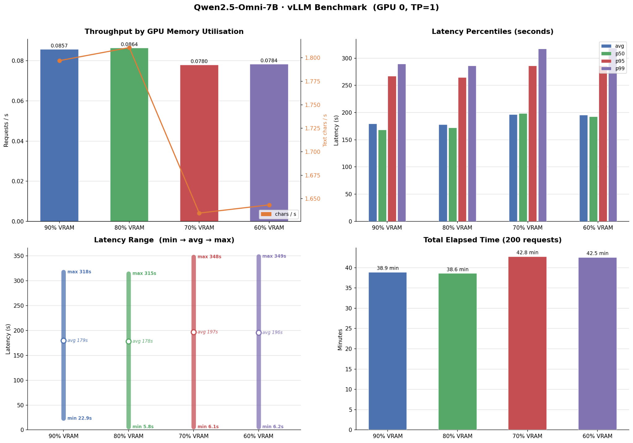
Results

Slide 9
Issue
100% failure rate on GPU 1
Error type APITimeoutError
Elapsed time: 6.5 hours

Slide 10
Findings
80% VRAM is the sweet spot
60% VRAM
70% VRAM
80% VRAM
90% VRAM
Throughput (r/s)
0.0784
0.0780
0.0864
0.0857
Avg Latency
195.7s
196.8s
178.0s
179.5s
P95 Latency
286.0s
286.4s
264.8s
267.1s

Slide 11
Understand
how GLMs work and search Qwen Image

Slide 12
GLM Architecture
Zhipu AI & Tsinghua University - https://arxiv.org/pdf/2507.01006 - https://docs.z.ai/guides/vlm/glm-4.6v
335B
32B
128K
Token Design
Per Forward Pass
Token Support
GLM-4.5 is a massive 355-billion parameter model utilizing a Mixture-of-Experts (MoE) design, efficiently activating only 32 billion parameters per forward pass.
It features a dual-mode execution framework that switches between a high-latency "Thinking Mode" for complex, multi-step planning and an instantaneous "Non-Thinking Mode" for standard, interactive tasks.
The newer GLM-4.6V advances the architecture by supporting native multimodal tool calling, allowing the model to directly ingest images, UI screenshots, and visual snippets as parameters without needing to convert them to text first.
.

Slide 13
Qwen-VL Architecture
Input
Image
ViT-bigG
Encoder
Cross-Attn
Adapter
256-Token
Compression
Qwen LLM
Backbone
Qwen-VL takes a different structural approach by adding a dedicated "visual receptor" to the Qwen language model.
It uses a Vision Transformer (ViT-bigG) to encode the image, followed by a position-aware cross-attention adapter that compresses the vast sequence of image features into a fixed, manageable length of 256 tokens while retaining 2D positional data.
The latest iteration, Qwen3-VL, can natively process up to 1 million tokens, allowing it to parse hour-long videos frame-by-frame and operate UI interfaces as a visual agent
.

Slide 14
Some models that can generate vision task and text tasks
Qwen3-VL
Exceptional at video understanding, UI navigation, and multilingual optical character recognition (OCR)
GLM-4.6V
Exceptional at video understanding, UI navigation, and multilingual optical character recognition (OCR)
Gemma 3
Google's lightweight VLM family (1B to 27B parameters) offering strong reasoning across 35+ languages and highly portable designs suitable for edge devices
DeepSeek-OCR
Redefines text processing via "Contexts Optical Compression," encoding dense document images into highly compressed vision tokens instead of lengthy raw text tokens, enabling complex document and chemical formula parsing at high speeds

Slide 15
Some models that can generate vision task and text tasks
Pixtral
Mistral's 12B instruction-tuned model, pre-trained on interleaved image and text documents, specifically excelling at multi-image conversations natively.
Molmo
A highly efficient family of models by the Allen Institute for AI, trained on detailed audio-transcribed image captions, which gives it unique "pointing" capabilities to identify spatial coordinates of objects

Slide 16
Omni models with diffusion
X-Omni (Tencent)
Uses unified reinforcement learning to perfectly align an AR model (Qwen2.5-7B) with a diffusion decoder (FLUX.1-dev), enabling best-in-class text-in-image rendering
Omni-Diffusion
Abandons the AR backbone entirely, using mask-based discrete diffusion to capture joint distributions across text, speech, and images in a unified way
Dream 7B
Abandons left-to-right generation, instead iteratively denoising fully corrupted sequences to allow for arbitrary-order generation and superior constraint-based planning

Slide 17
Resource Requirements
LLMs vs Diffusion Models
LLMs
Diffusion
Model Size | FP16 VRAM | INT4 VRAM
7B | 16–20 GB | 6–8 GB
33B | 70–80 GB | 20–28 GB
70B | 140–160 GB | 40–48 GB
GLM-4.5 (355B) | 823 GB | 210 GB
Unlike LLMs, diffusion policies are primarily constrained by raw compute.
Generating an output requires iterative denoising (10 to 100 steps), which continuously saturates accelerator cores with dense matrix multiplications.
On edge or mobile hardware, this sustained compute pressure rapidly hits thermal ceilings, triggering hardware throttling and severe latency spikes that often drop control frequencies to just 1-2 Hz.
Diffusion models offer a unique advantage: you can explicitly dial down the number of diffusion timesteps to speed up inference, trading speed for fidelity.
KV-Cache Context Pressure:
+6 GB per 8K tokens on a 7B model
+20 GB per 8K tokens on a 70B model
INT4 quantization cuts VRAM by ~4×

Slide 18
Next Steps
work on research poster(due 31st March)
shift from the voice agent to general omni model optimizing.( Work on the code Hongrui sent)
do survey about multiplexing
MuxWise https://arxiv.org/pdf/2504.14489
Bullet https://arxiv.org/pdf/2504.19516v2
understand the resource requirement
Notes:
Thats all for up my update.

Slide 19
Mar 24, 2026
studying for midterm

Slide 20
Mar 16, 2026

Slide 21
Recap
shift from the voice agent to general omni model optimizing.( Work on the code Hongrui sent) (NSCC down)
do survey about multiplexing
USher https://www.usenix.org/system/files/osdi24-shubha.pdf
Orion https://dl.acm.org/doi/10.1145/3627703.3629578
MuxServe https://arxiv.org/abs/2404.02015

Slide 22
Survey
Focus: Omni-Models & Prefill–Decode Dynamics

Slide 23
USher: Holistic Interference Avoidance
Shubha, Shen, Iyer · University of Virginia & Georgia Tech · OSDI 2024
Inference Requests
Resource Requirement Estimator
(Kernel-level profiling)
Interference-Aware Scheduler
(Batch size · Replication · Placement)
Operator Graph Merger
(Cache-aware co-execution)
GPU Resources (SMs + Memory)
Core Problem
Spatial GPU multiplexing causes inter-model interference compute utilization (Cuti) and memory utilization (Muti) are not simultaneously maximized by existing systems.
Key Innovations
▸ GPU Kernel-based resource requirement estimator (profiles Cuti + Muti jointly)
▸ Interference-aware scheduler: sets batch size, replication degree, and placement holistically
▸ Operator graph merger: merges model computation graphs to reduce GPU cache pressure
Baseline vs USher (Cuti / Muti)
AlpaServe: Cuti 55–99% · |Cuti−Muti| up to 45% gap
GPUlet: Cuti 55–97% · |Cuti−Muti| up to 40% gap
Shepherd: Cuti 41–97% · |Cuti−Muti| up to 52% gap

Slide 24
Orion: Interference-aware Fine-grained GPU Sharing
Strati, Ma, Klimovic · ETH Zürich · EuroSys 2024
Client A (High-Priority)
Kernel Launches
Orion Scheduler
Software Queue · Operator-level profiling
Interference-Free Co-scheduling
Compute-bound + Memory-bound pairing
GPU Execution
(SM + Memory BW fully utilized)
Client B (Best-Effort)
Kernel Launches
Core Problem
DNN operators alternate between compute-bound and memory-bound. Co-scheduling complementary operators from different jobs fills idle resources without mutual interference.
Mechanism
▸ Transparently intercepts CUDA / cuDNN / cuBLAS kernel launches via library interposition
▸ Schedules at individual operator granularity (10s of μs), finer than any prior work
▸ Priority model: one high-priority inference job + best-effort collocated jobs
▸ Profiles each operator's SM count and memory BW requirements offline

Slide 25
MuxServe: Flexible Spatial-Temporal Multiplexing
Duan, Lu, Duanmu, Li et al. · CUHK / UCSD · ICML 2024
Performance Results
Multiplexing Timeline
1.8×
2.9×
Partition A
LLM-A Prefill
LLM-A Decode
Throughput Gain
SLO Attainment
Partition B
LLM-B Decode
LLM-B Prefill
vs. spatial partition baseline
more requests within 99% SLO
Core Problem
Serving multiple LLMs simultaneously: popular LLMs create GPU hotspots, while less popular ones leave GPUs idle. Static spatial partition wastes resources.
Design Principles
▸ Popularity-Aware Colocation: colocate popular + less-popular LLMs to share idle resources
▸ Computation-Aware Multiplexing: disaggregate prefill & decode phases; allocate SMs per job dynamically via NVIDIA MPS
▸ Unified Memory: single KV cache table shared across colocated LLMs; head-wise blocks (128-dim) allow cross-model reuse
▸ ADBS algorithm: placement optimizer + adaptive batch scheduler for maximal utilization

Slide 26
Current Landscape: Comparing the Systems
System | Scope | Sharing Type | Granularity | SLO-Aware | vLLM-based | Key Limitation
USher | Multi-model | Spatial | Model-level | Partial | No | No P/D disaggregation
Orion | Multi-client | Spatial-Temporal | Operator-level | No | No | Priority model only
MuxServe | Multi-LLM | Spatial-Temporal | Phase-level | Yes | Yes | Static MPS allocation

Slide 27
Next Steps
shift from the voice agent to general omni model optimizing.( Work on the code Hongrui sent) (NSCC down)
find some models that can generate vision task and text tasks
look at omni models with diffusion components (GLM) understand resource requirements for LLM and diffusion models
First understand how GLM work <- search Qwen image
do survey about multiplexing
MuxWise https://arxiv.org/pdf/2504.14489
Bullet https://arxiv.org/pdf/2504.19516v2
understand the resource requirement
Notes:
Thats all for up my update.

Slide 28
Mar 10, 2026
mid term

Slide 29
Mar 3, 2026

Slide 30
Recap
Add function calling (search and database retrieval)
FAISS
read ShardMemo

Slide 31
Plan
Agentic Voice RAG Pipeline Overview
Notes:
Hi everyone, thanks for making the time. Today I want to give you an update on the Agentic Voice RAG Pipeline I've been building, walk through a technical roadblock we hit during the batched execution, and then review the ShardMemo paper

Slide 32

Design Graph
Intent and Planning
Audio Generation
Decoding
Output
Input
(User Audio)
Thinker
Qwen2.5-Omni-7B
Talker
(Generates Audio Codec Tokens)
Token2Wav
(Converts Tokens to Audio)
Final .wav response and .txt output
If tool needed
Tool Executor
Local RAG: FAISS Vector DB (Customer lookup)
Online Search: Web API (in progress)
Returns context
Why ?
Simulates enterprise voice agents handling multi-step reasoning
Mirrors the architecture of Bank of America's Erica (handling 3B+ interactions via ReAct tool-calling).
Notes:
Here is the high-level design of the pipeline. It takes user audio and feeds it into the 'Thinker' using Qwen2.5-Omni. If the Thinker decides it needs external data, it triggers our Tool Executor. Right now, that’s a local FAISS Vector DB for secure customer lookups, and I am working on adding an online search API next.
Once the data is retrieved, it goes back to the Thinker, passes to the 'Talker' to generate audio codec tokens, and finally to 'Token2Wav' to output a conversational audio file. I chose this architecture because it simulates enterprise-grade agents specifically, it mirrors the ReAct tool-calling architecture used by Bank of America’s Erica, which handles billions of interactions.

Slide 33
Real-World Use Case: Personalized Financial Concierge
Traditional call center IVR (Interactive Voice Response) systems are rigid and frustrating (e.g., "Press 1 for balance"), while human support is expensive and suffers from high wait times.
The Solution: A fully autonomous, voice-in/voice-out agent capable of reasoning through complex queries and securely fetching private user data in real-time.
Zero Hold Times: Instantly handles routine, high-volume tier-1 support tickets.
Data Privacy: Uses local RAG (FAISS) to keep sensitive customer data entirely in-house, rather than leaking it to public models.
Dynamic Context: Moves beyond scripted answers by using real-time database lookups.
🗣️-> 🧠-> 🔍->🔊
User Question (Hi, my phone number is +1234567890. Can you check my account balance?)
Agent Reasoning (Thinker)
Secure Retrieval
Agent Response (Hello Esther! You are on the Premium plan and your current balance is $0.00. )
Notes:
a real-world use case for this is a traditional call center IVR systems. They are rigid, frustrating, and say things like 'Press 1 for balance.' Human support, on the other hand, is expensive and has long wait times.
The solution is a fully autonomous concierge. Because it uses local RAG with FAISS, this pipeline achieves zero hold times for tier-1 support, but more importantly, it guarantees data privacy. Sensitive customer data stays entirely in-house instead of leaking to public LLMs, and the agent uses real-time database lookups to provide dynamic context rather than scripted answers

Slide 34
Current Status & Technical Roadblock
Stage 1 successfully transcribed all 105 files and accurately executed FAISS RAG lookups.
Stage 2/3 (Audio Synthesis) crashed
Using stochastic sampling (temperature=0.9), the "Talker" module randomly hallucinated an out-of-vocabulary audio token ID.
"Token2Wav" attempted an embedding lookup for this invalid ID, triggering a CUDA device-side assert (index out of bounds).
This caused the script to hang until the 8 hour PBS walltime killed the job
Trying to give more GPU access/ change max_model_len
Notes:
In terms of current status, Stage 1 is successful—the model transcribed all 105 test files and successfully executed the FAISS database lookups.
However, I hit a technical roadblock during the audio synthesis stage. Because audio tokens consume a massive amount of context, the pipeline exceeded its memory allocation. The model attempted to fetch a positional embedding beyond the set limit, which triggered a CUDA 'device-side assert' out-of-bounds error and crashed the GPU. I am currently fixing this by expanding the max_model_len configuration so the GPUs have enough headroom for the full audio sequences.

Slide 35
Review
Literature Review: ShardMemo: Masked MoE Routing for Sharded Agentic LLM Memory
Notes:
Next is the literature review, ShardMemo: Masked Mixture-of-Experts Routing for Sharded Agentic LLM Memory

Slide 36
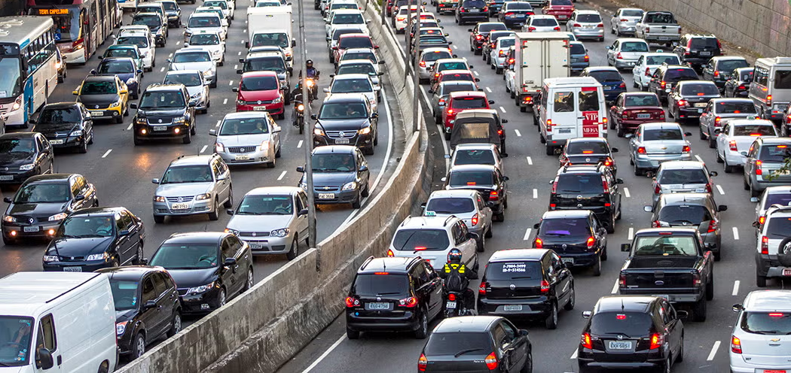
The Bottleneck
Long-horizon agents hit a "Memory Wall."
Central indexes cause latency spikes and locks.
Sharding solves storage but breaks retrieval.
Notes:
The core problem this paper addresses is the 'Memory Wall' for long-horizon agents. As an agent operates over time, its memory grows. Traditional central indexes cause massive latency spikes and lock up the system. Sharding the memory solves the storage issue, but it breaks the retrieval process because the agent doesn't know which shard to look in.

Slide 37
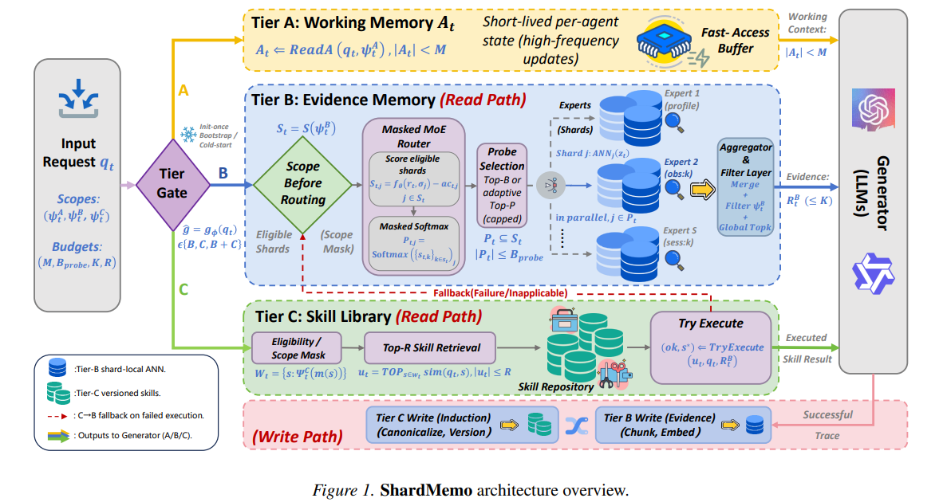
ShardMemo's 3-Tier Architecture
Tier A (Working): Fast, short-term context (RAM).
Tier B (Evidence): Sharded logs accessed via Masked MoE routing.
Tier C (Skills): Versioned tool library.
Notes:
ShardMemo solves this by introducing a 3-Tier Architecture:
Tier A is working memory—fast, short-term context kept in RAM.
Tier B is Evidence memory, which holds sharded logs.
Tier C is the Skills memory, which acts as a versioned tool library.

Slide 38
Key Mechanisms
ShardMemo introduces specific mechanisms to optimize retrieval accuracy and cost, particularly within Tier B:
Scope Before-Routing: Enforces eligibility constraints (tenant, permissions) before shard search.
Cost-Aware Gating: Organizes memory into cost-heterogeneous shard families (profiles, observations, sessions). The router prioritizes cheaper shards (e.g., profiles) and only accesses expensive episodic shards when required.
Supervised Router Training: When evidence-to-shard labels are available, the router is trained using a multi-positive set-likelihood objective to improve selection accuracy.
Notes:
To optimize Tier B, they use a few clever mechanisms. First is 'Scope Before-Routing', which strictly filters out data the user doesn't have permission to see before searching. Next is 'Cost-Aware Gating'—the router prioritizes cheaper, smaller shards like user profiles before it spends compute searching expensive episodic logs. Finally, they use supervised router training to make the model highly accurate at selecting the right shard

Slide 39
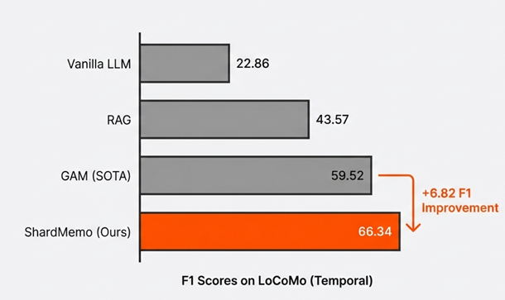
Performance Results
+6.82 F1 score improvement on LoCoMo.
Retrieval work reduced by 20.5%.
Latency dropped from 95ms to 76ms.
Notes:
The results of this architecture are On the LoCoMo benchmark, ShardMemo achieved a 6.82 point increase in F1 score. It also reduced the total retrieval workload by 20.5%, bringing latency down from 95 milliseconds to 76 milliseconds. It proves that a budgeted, tiered memory approach is highly effective for scaling these agents.

Slide 40
Next Steps
Add function calling (search and database retrieval) using FAISS ( try to fix issue )
Integrate the external Online Web Search function alongside the existing FAISS RAG to handle real-time, out-of-database queries.
Notes:
Thats all for up my update.

Slide 41
Tiered Memory Architecture
It is organised into 3 distinct tiers to handle heterogeneousaccess patterns
• Tier A (Working Memory): Stores short-lived, per-agent working state to stabilize short-term context. It operates under a bounded budget (M).
• Tier B (Evidence Memory): Stores persistent declarative evidence partitioned into shards, each with a local Approximate Nearest Neighbor (ANN) index. This tier is designed for scalable retrieval of interaction logs and observations.
• Tier C (Skill Library): A library of versioned, reusable skills (procedures). It allows agents to retrieve and execute previously successful tool-use procedures under a budget (R). If a skill is inapplicable or execution fails, the system falls back to Tier B.
The Problem:
ShardMemo is a budgeted tiered memory service designed to address scalability and efficiency bottlenecks of external memory in agentic LLM systems.
The solution:
Replace centralized indexes and heuristic partitioning with a structured, cost-aware approach to managing long-horizon state and multi agent execution

Slide 42
Key Mechanisms
ShardMemo introduces specific mechanisms to optimize retrieval accuracy and cost, particularly within Tier B:
• Scope-Before-Routing: Instead of searching all shards, ShardMemo enforces structured eligibility constraints (e.g., tenant, permissions) before routing.
• Cost-Aware Gating: The system organizes memory into heterogeneous shard families (e.g., profiles, observations, sessions) with different access costs. The router uses cost-aware gating to prioritize cheaper shards (like profiles) and only escalates to expensive episodic shards when necessary.
• Supervised Router Training: When evidence-to-shard labels are available, the router is trained using a multi-positive set-likelihood objective to improve selection accuracy.

Slide 43
Performance Results
ShardMemo demonstrates significant improvements over existing baselines (such as GAM and standard RAG) in diverse benchmarks:
• LoCoMo: It improved F1 scores by +5.11 to +6.82 across question categories compared to the strongest baseline. With a fixed routing budget, it increased F1 by +6.87 while reducing retrieval work (vectors scanned) by 20.5% and p95 latency from 95ms to 76ms.
• HotpotQA: It maintained strong performance on long-context tasks, achieving high F1 scores even as context lengths grew from 56K to 448K tokens.
• ToolBench: The Tier C skill library achieved 0.97 Precision@3 and improved step reduction by +7.2% compared to embedding-similarity retrieval, indicating high reliability in skill reuse.

Slide 44
Feb 24, 2026
studying for a mid term paper

Slide 45
Feb 17, 2026
CNY

Slide 46
Feb 10, 2026

Slide 47
Recap
Upgrade current AI project from a multi-server setup to a Single, offline Python Script using Qwen2,5-Omni and vLLM-Omni 0.11.0 to handle audio-to-text-tool-use natively on the GPU (on-going)
write vllm omni guide

Slide 48
Objective and Architecture
Evaluate the throughput efficiency of Qwen2.5-Omni multimodal model
Processed over 100 (105) concurrent audio inputs to simulate a high-traffic inference request queue
length of audio files
Count: 105, Average Duration: 2.82 seconds, Min: 1.51s | Max: 8.21s
Used Qwen2.5-Omni-7B
Inference Backend : vLLM-Omni
Notes:
Good afternoon. Today I’ll be presenting the performance evaluation of the Qwen2.5-Omni multimodal model.
The objective of this experiment was to evaluate throughput efficiency under high-concurrency conditions. I did this by processing 100 audio inputs concurrently.
I selected N = 100 because this scale is sufficient to expose GPU memory fragmentation issues. In conventional systems, large batches with variable-length inputs often fail due to fragmented memory, even when total free VRAM is available.
The model used was Qwen2.5-Omni-7B, deployed with the vLLM-Omni backend. vLLM-Omni uses PagedAttention, which allocates KV-cache memory in pages rather than contiguous blocks, enabling stable execution of large, heterogeneous batches.

Slide 49
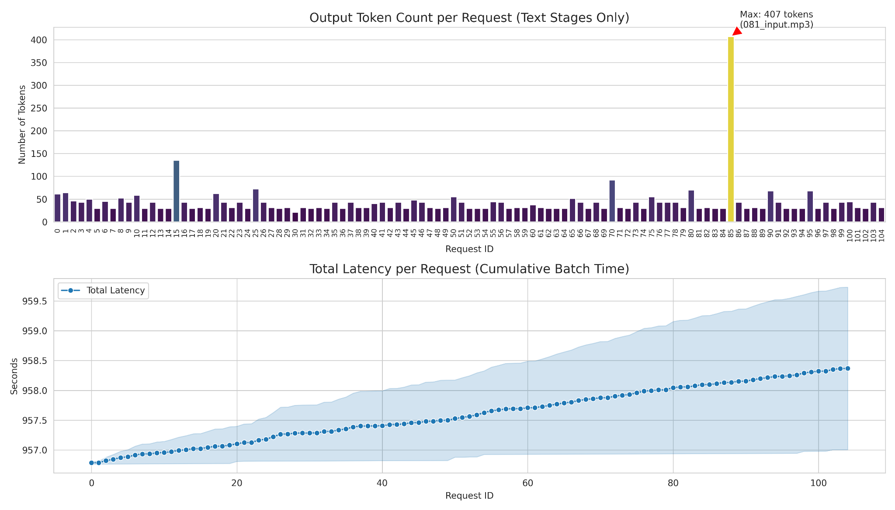
Output Token Count
The number of text tokens (words/sub-words) the model generated in response to the audio prompt.
Average Output:~45 tokens per request
Maximum Output : 407 tokens
Despite Request 85 demanding 10x the compute, the batch did not fail.
Notes:
To make this work, I connected three distinct parts running on the GPU. First, I use Whisper on Port 8000 to convert audio into text. Second, I use GPT-OSS on Port 8001 to handle the logic and decide if a tool is needed. Finally, I use Google TTS to convert the text response back into audio so the system can speak. The reason I built it this way is that GPT-OSS is a text-only model, so it cannot natively "hear" audio like the new Llama-Omni models. By wrapping it in this pipeline, I effectively gave GPT-OSS hearing and speaking capabilities

Slide 50
Latency Per Request
The wall-clock time from the start of the batch until the specific request was saved to disk.
It took ~1.6 seconds to loop through and save 100 files.
Total Batch Time:~958 s
Total Req:105
Effective Latency = 9.1 seconds per req
Notes:
To make this work, I connected three distinct parts running on the GPU. First, I use Whisper on Port 8000 to convert audio into text. Second, I use GPT-OSS on Port 8001 to handle the logic and decide if a tool is needed. Finally, I use Google TTS to convert the text response back into audio so the system can speak. The reason I built it this way is that GPT-OSS is a text-only model, so it cannot natively "hear" audio like the new Llama-Omni models. By wrapping it in this pipeline, I effectively gave GPT-OSS hearing and speaking capabilities

Slide 51
Conclusion
The vLLM-Omni architecture successfully managed high-concurrency loads (N=100) without memory degradation.
Notes:
To conclude the first workstream: unlike text and vision workloads, no public production-scale audio inference trace dataset is currently available. Existing resources either capture input data without system behavior details, or system behavior without the necessary modality-specific details.

Slide 52
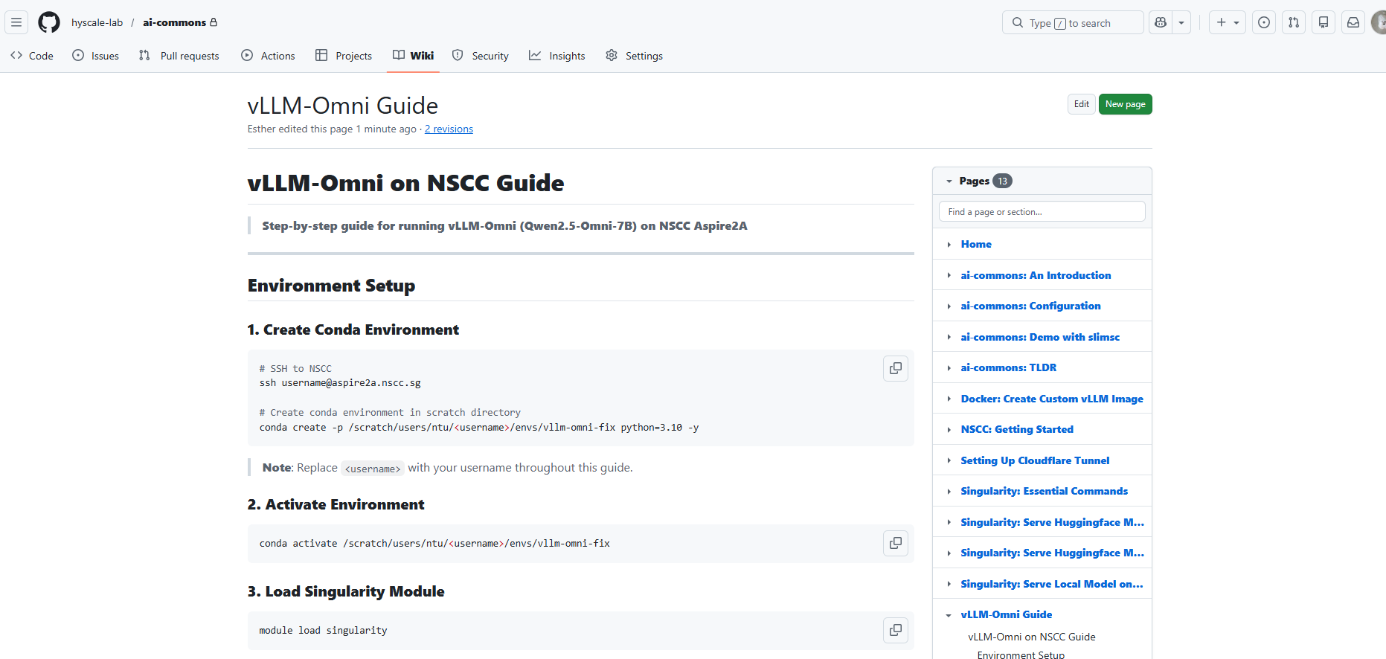
vLLM-Omni Guide
Access it through the link
https://github.com/hyscale-lab/ai-commons/wiki/vLLM%E2%80%90Omni-Guide

Slide 53
Next Steps
Add function calling (search and database retrieval)
FAISS
read ShardMemo

Slide 54
Feb 4, 2026
caught a viral infection, sick.
VLLM Omni works (Implementing it now)

Slide 55
Jan 28, 2026

Slide 56
Recap
Upgrade previous Pipeline with Branch Tracking and Resource Monitoring Tracks execution paths, GPU memory, and detailed timing for reasoning analysis

Slide 57
Architecture (Compound AI System)
Perception: whisper-large-v3 (Port 8000)
Handles Audio-to-Text.
Reasoning: gpt-oss (Port 8001)
Handles Text-to-Text & Function Calling.
Synthesis: Google TTS (with local Wav fallback)
Handles Text-to-Audio.
Why this approach?
Since GPT-OSS is a text-only model, it cannot run as a native Omni model (like Llama-3.1-Omni).
This modular wrapper gives GPT-OSS "hearing and speaking" capabilities.
It allows us to isolate specific reasoning latency.
Notes:
To make this work, I connected three distinct parts running on the GPU. First, I use Whisper on Port 8000 to convert audio into text. Second, I use GPT-OSS on Port 8001 to handle the logic and decide if a tool is needed. Finally, I use Google TTS to convert the text response back into audio so the system can speak. The reason I built it this way is that GPT-OSS is a text-only model, so it cannot natively "hear" audio like the new Llama-Omni models. By wrapping it in this pipeline, I effectively gave GPT-OSS hearing and speaking capabilities

Slide 58
Experimental Setup
https://huggingface.co/datasets/PolyAI/banking77
Synthetic Dataset Generation:
Total Samples: 100 Audio Files.
20% Tool Use: "Phone Number Lookups" (Requires precise parameter extraction).
80% General Chat: "Jokes," "Exchange Rates" (Requires creative text generation). (PolyAI/banking77)
Infrastructure (HPC Node):
Hardware: Single GPU Node (110GB RAM).
Optimization: Implemented Sequential Loading logic (Whisper First then GPT-OSS)
Notes:
To test this, I created a dataset of 100 audio files. I made 20% of them "Phone Number Lookups," which force the AI to use a tool, and 80% of them "General Chat," like telling jokes.

Slide 59
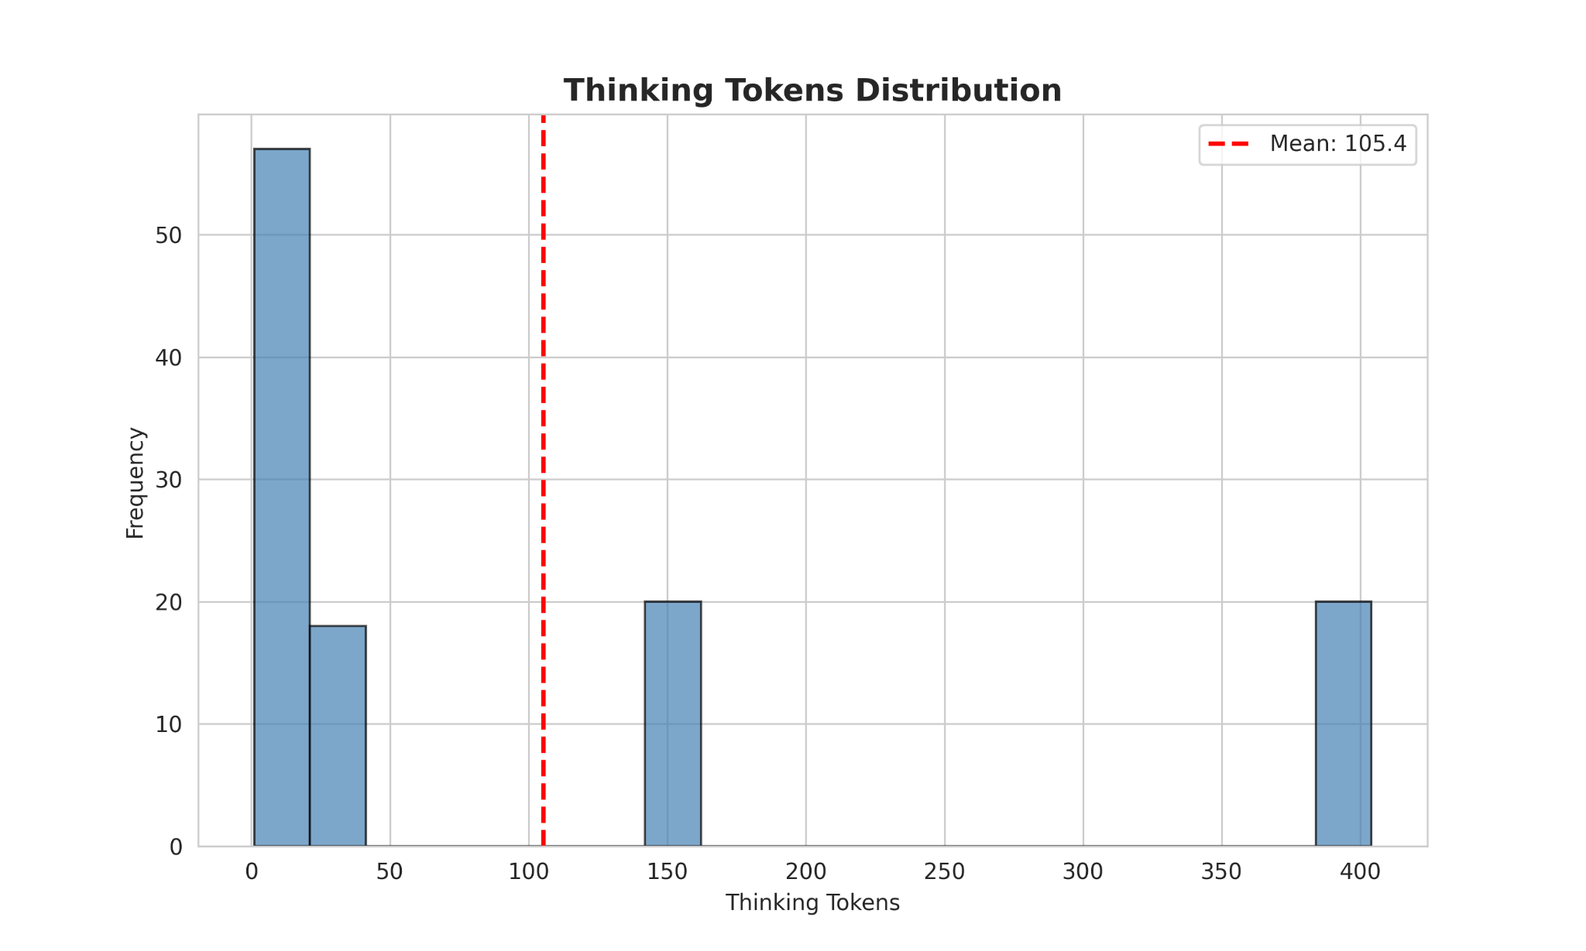
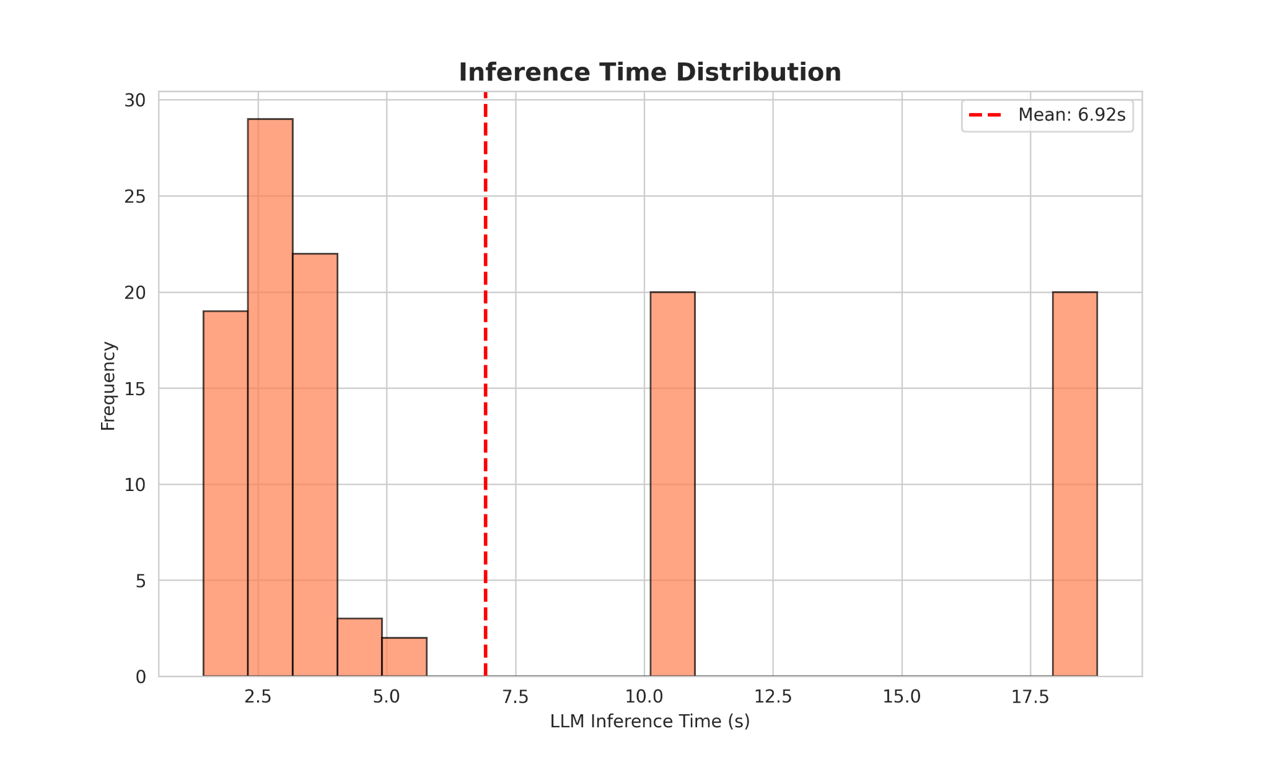
The Bimodal behaviour
Performance is bimodal, not uniform. The model switches between two distinct cognitive states.
Instinctive
Deliberate
76% of simple queries are handled in an “Instinctive” mode with zero thinking tokens and below 5 second latency. However, complex tasks trigger a “Deliberate state that generates ~400 reasoning tokens driving a 3.6x spike in response time to ~18 s.
Notes:
If you look at the graphs on the left, notice the empty space in the middle. This 'gap' tells us the model doesn't just get gradually slower as tasks get harder. Instead, it snaps into a completely different mode.
Mode A is what I call the 'Instinctive' mode. This covers about 76% of our traffic—things like looking up exchange rates. The model answers instantly, in under 5 seconds, with effectively zero internal reasoning.
Mode B is the 'Deliberate' mode. For that top 24% of complex queries, the model 'switches gears.' It generates nearly 400 internal thought tokens before it writes a single word of the answer.
The takeaway? That 'thinking time' is expensive. Entering Mode B automatically triples our user wait time from 5 seconds to 18 seconds.

Slide 60
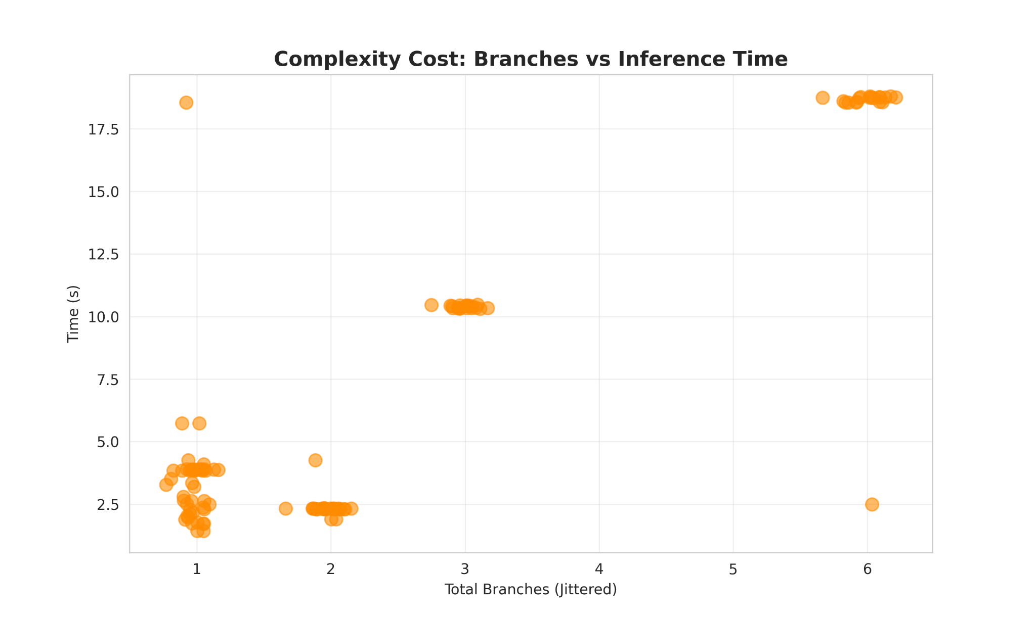
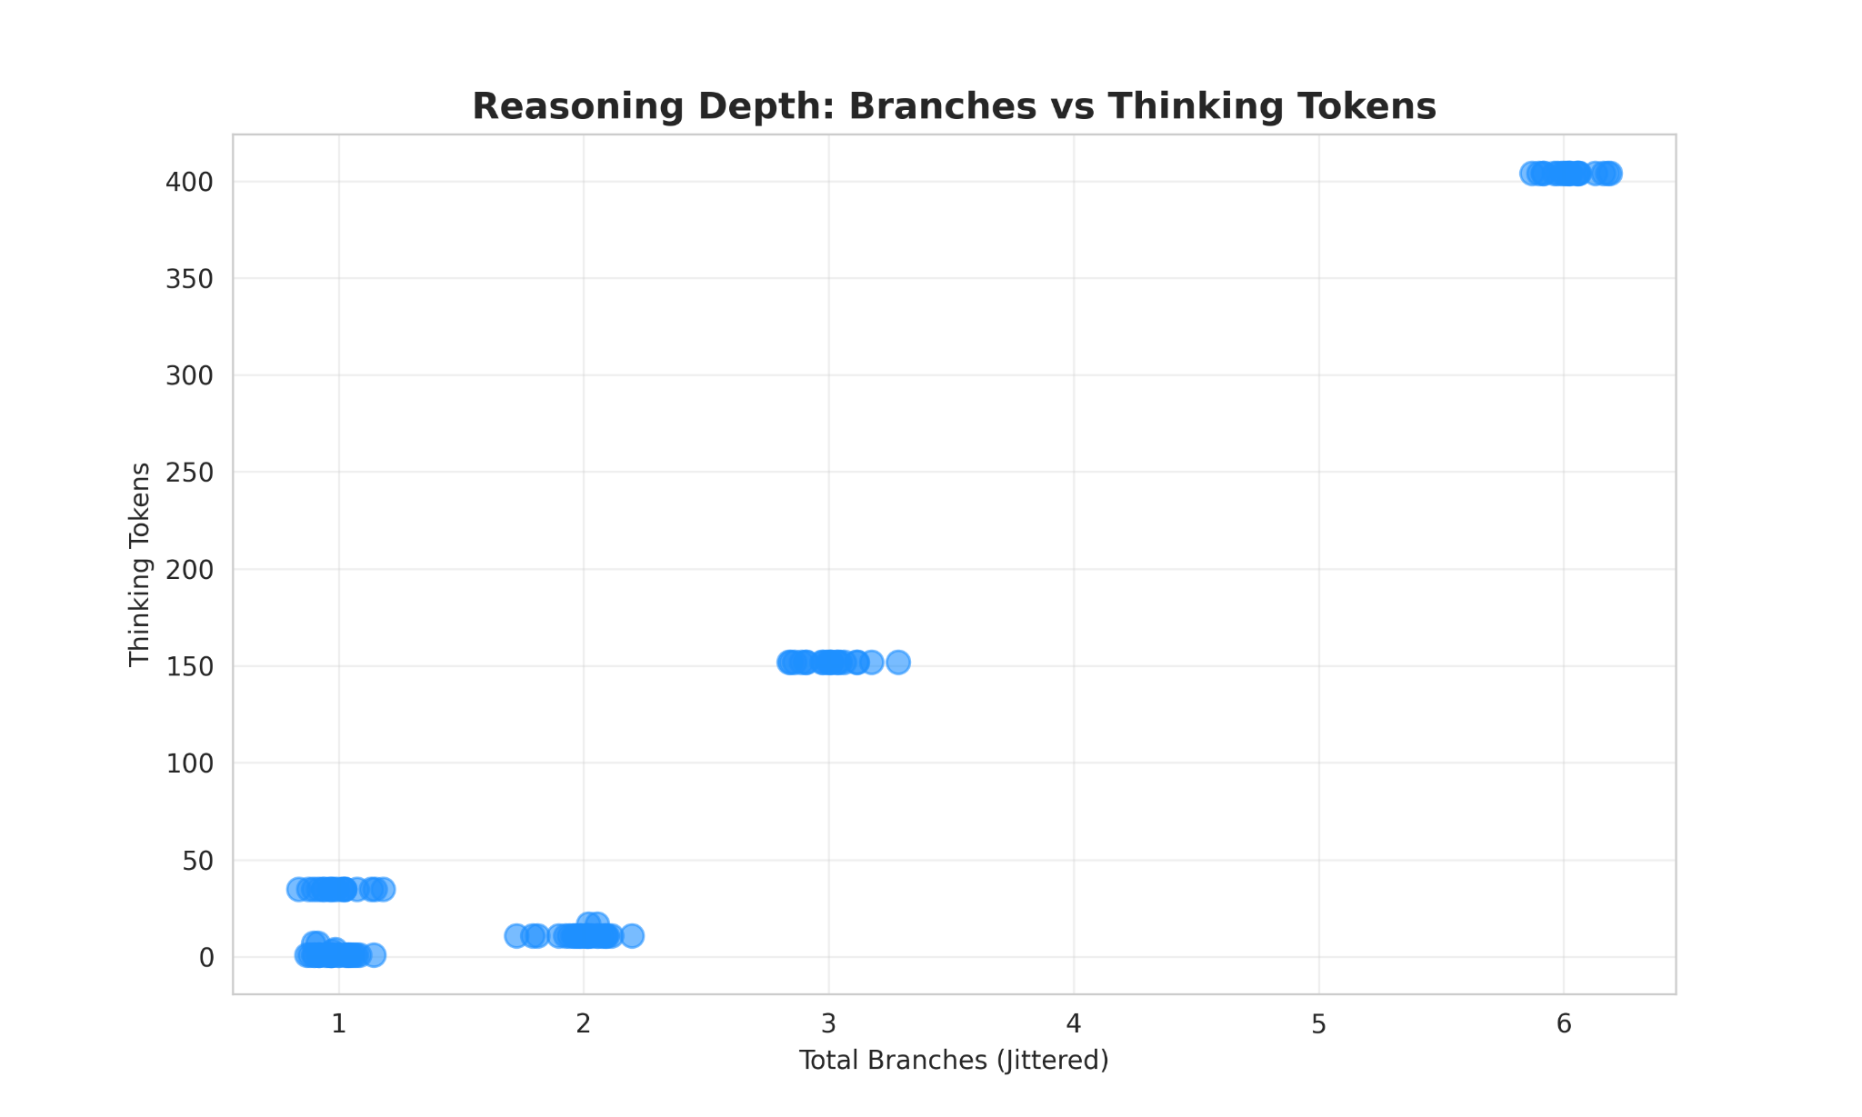
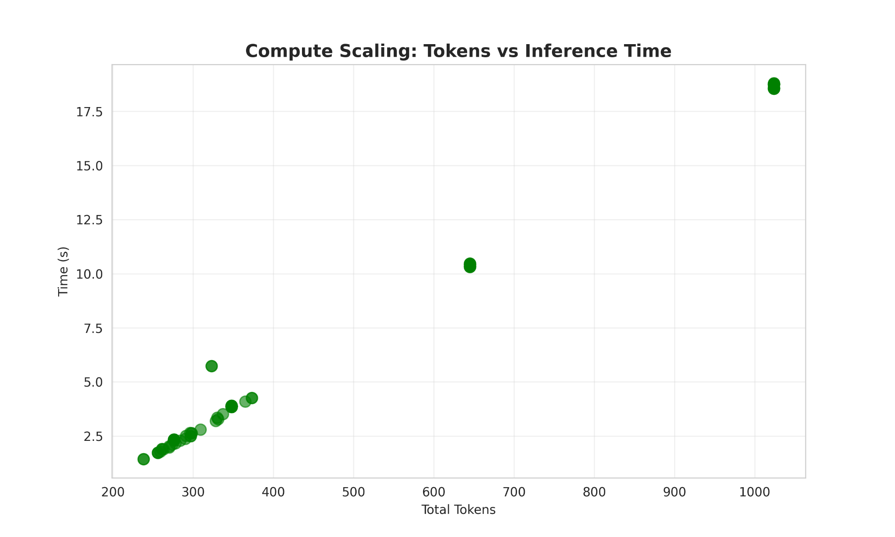
Cost of Complexity
Latency is the direct cost of structural reasoning.
Reasoning Tree Construction
+2.5s per Branch
Each additional logical step (branch) costs ~60 tokens of thought and adds ~2.5 seconds to the user wait time.
This shows that it is compute bound. The 18s delay is the price of building a 6-step reasoning tree
Notes:
"When the model enters 'Deliberate Mode,' it isn't just stalling; it is branching."
"Our data proves a direct linear relationship: every additional logical branch adds roughly 2-3 seconds to the user wait time."
"The 'Tokens vs. Time' chart confirms we are compute-bound. The delay is purely due to the volume of thought generation, not system overhead."
Insight: "The model doesn't just guess on complex tasks; it constructs a 6-step reasoning tree before answering. This latency is the 'price' of accuracy."

Slide 61
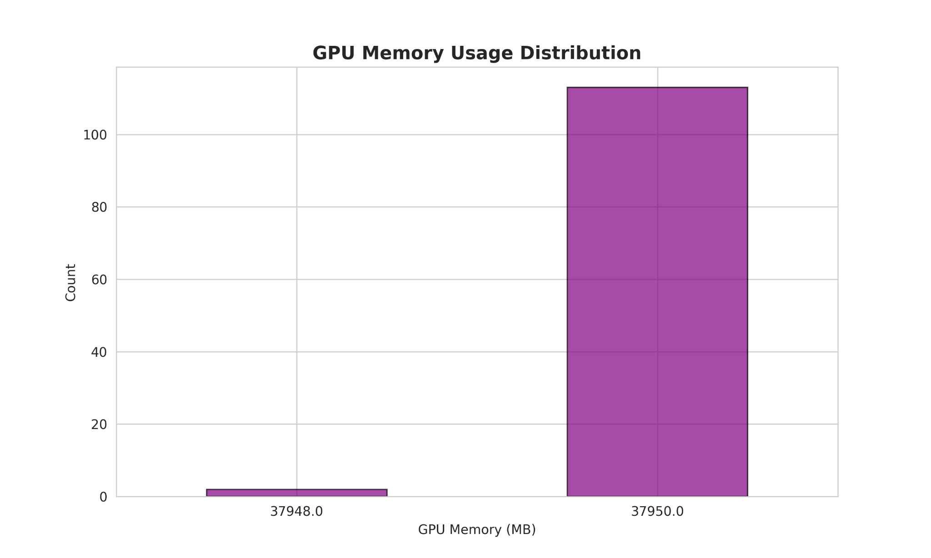
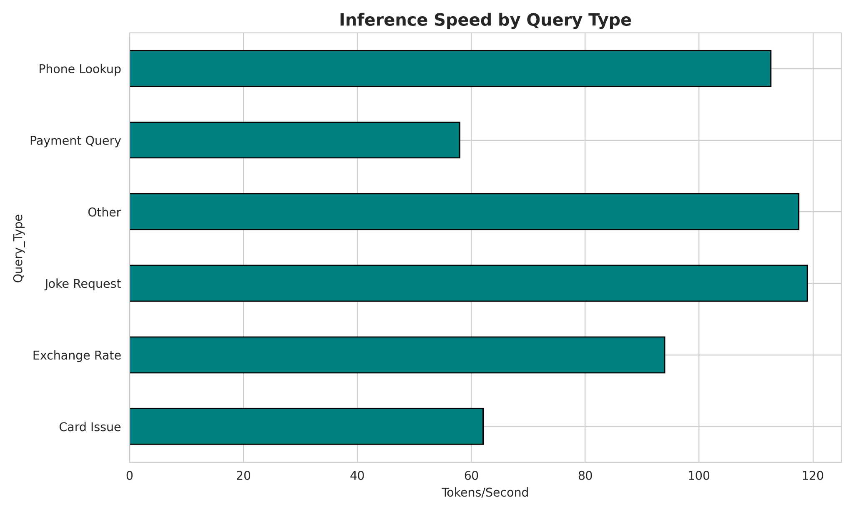
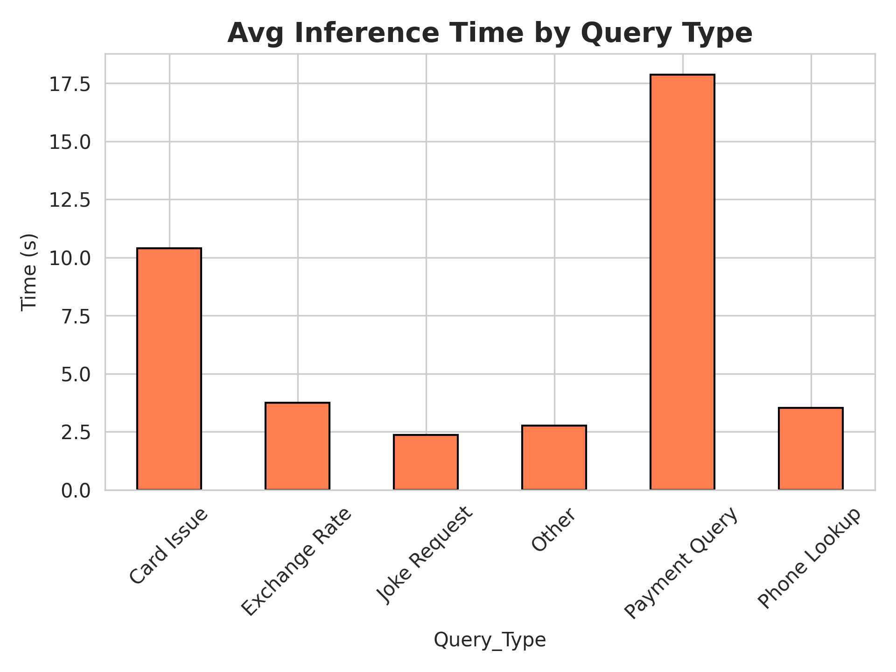
Operational Impact
Latency is not random overhead; it is the direct cost of structural reasoning.
Static Memory Footprint (38GB)
50% Throughput Drop
Memory usage is static (reserved at 38GB), but time usage is highly volatile.
Complex reasoning comes with a 50% speed penalty.
Simple Queries take ~120 tokens/sec and Complex Queries ~60 tokens/sec
Notes:
"This 'thinking' capability comes with a 50% throughput penalty. While we get 120 tokens/sec on simple tasks, complex reasoning drops us to 60 tokens/sec."
"Memory usage is static—the model reserves ~38GB regardless of the task—but our time resources are heavily skewed by just two query types: 'Payment' and 'Card Issues'."

Slide 62
Conclusion
results show that latency and throughput degradation are not incidental, but an inherent cost of structured reasoning. This highlights the need for systems-level strategies that selectively invoke or amortize expensive reasoning paths.
Notes:
To conclude the first workstream: unlike text and vision workloads, no public production-scale audio inference trace dataset is currently available. Existing resources either capture input data without system behavior details, or system behavior without the necessary modality-specific details.

Slide 63
Next Steps
Upgrade current AI project from a multi-server setup to a Single, offline Python Script using Qwen2,5-Omni and vLLM-Omni 0.11.0 to handle audio-to-text-tool-use natively on the GPU (on-going)
measure accuracy vs branch number, ttft, tbt
write vllm omni guide

Slide 64
Jan 21, 2026
Not feeling well

Slide 65
Jan 14, 2026

Slide 66
Recap
Upgrade previous Pipeline with Branch Tracking and Resource Monitoring Tracks execution paths, GPU memory, and detailed timing for reasoning analysis (on-going)
Read the paper of New Trends for Modern Machine Translation with Large Reasoning Models

Slide 67
On-going
Implement Monitoring Infrastructure
Upgrade the pipeline with Branch Tracking and Resource Monitoring to log execution paths, GPU memory usage, and detailed timing for reasoning analysis. (On-going)

Slide 68
Review
Literature Review: Large Reasoning Models (LRMs) "New Trends for Modern Machine Translation with Large Reasoning Models"

Slide 69
Introduction/Motivation
Machine Translation (MT) is shifting from Neural MT (NMT) and standard LLMs to Large Reasoning Models (LRMs).
Problem/Gap
Traditional models view translation as simple text-to-text mapping (X->Y) and struggle with deep context, cultural nuances, and discourse due to a lack of explicit reasoning.
The Thesis:
LRMs (OpenAI-o1, DeepSeek-R1) redefine translation as a dynamic reasoning task.
Using Chain-of-Thought (CoT), LRMs act as multilingual cognitive agents, not just text converters.

Slide 70
Background
Neural Machine Translation (NMT)
Uses deep learning to capture linguistic patterns
Limitations: Struggled with idiomatic expressions, low-resource languages, and document-level coherence
Large Language Models (LLMs)
We stopped needing to build specialized translation engines for every language , one AI can now learn to translate instantly just by seeing a couple of examples
Limitations: Performance inconsistencies in zero-shot style transfer and lack of interpretability in decision-making
The Evolution to LRMs
This paper builds on the emergence of Reasoning Models that generate "thought tokens" (reasoning traces) before producing the final output, allowing for self-correction and deeper linguistic analysis.

Slide 71
Methods/Approach
LRMs utilize Chain-of-Thought (CoT) reasoning to break translation into interpretable sub-problems: Plan -> Draft -> Critique -> Finalize.
The authors analyze the behavior of LRMs in complex translation scenarios: Stylized Translation, Document-Level Translation, and Multimodal Translation.
3 Foundational Shifts
Contextual Coherence: Explicit reasoning over cross-sentence contexts to resolve ambiguities.
Cultural Intentionality: Inferring speaker intent (e.g., "Is this sarcastic?") to adapt tone.
Self-Reflection: Iterative self-correction (e.g., Fixing "The hunter is the one who hunts" to "The one who captures is the hunter").
Experiments
Tested on Japanese Haikus & Spanish Poetry
Evaluated consistency in long-form text
Used visual inputs (e.g., Sign Language images) to resolve textual ambiguity.

Slide 72
Results/Findings
Stylized Translation:
LRMs excel at scenario-based word choice.
Trade-off: Risk of "over-localization," prioritizing target language norms over source structure (e.g., Haiku syllable counts ignored for better flow in Chinese).
Document-Level Translation:
Superior in maintaining terminology and tone consistency in long scientific abstracts compared to non-reasoning models.
Multi-Modal Reasoning:
Successfully uses visual context (images) to disambiguate text (e.g., identifying a "hunter" as human or tiger from a photo).
Cryptographic Reasoning:
Can decipher simple codes (Caesar ciphers) by pattern deduction without explicit keys.
Failure Case: Struggles with complex ciphers (Vigenère) without keys, leading to hallucinated solutions.

Slide 73
Discussion & Implications
Emergent Phenomenon: Auto-Pivot Translation:
LRMs spontaneously use high-resource languages (like English) as a "bridge" for low-resource pairs (e.g., Irish → English → Chinese) without instruction
Improves reasoning but may introduce latency and cultural distortion
Evaluation Gap:
Current metrics (COMET, BLEURT) are insufficient for LRMs. They penalize correct, diverse translations that deviate from rigid reference texts
Robustness via Self-Reflection:
LRMs show unique resilience against noisy inputs (typos/scrambled text) by inferring intended meaning rather than translating literally

Slide 74
Future Research
Inference Efficiency::
Long CoT reasoning chains create high computational overhead and latency, preventing real-time application
Direction: Research into pruning redundant reasoning steps and model compression
Addressing Over-Localization:
Finding the balance between preserving source text authenticity and achieving target language fluency
Complex Reasoning & Hallucination:
Improving model honesty so they admit uncertainty in complex tasks (like cryptography) rather than hallucinating answers
Specialized Domains
Enhancing multi-modal capabilities for specific tasks like Sign Language interpretation, where current models still struggle

Slide 75
Conclusion
Redefining Translation: LRMs represent a paradigm shift, transforming translation systems from text converters into cognitive agents.
Key Takeaway: By dynamically reasoning about context, culture, and intent, these models open new possibilities for cross-cultural communication.
Final Thought: The future of MT lies in moving beyond linguistic challenges to deeper reasoning tasks, though significant work remains in efficiency and evaluation

Slide 76
Next Steps
Upgrade previous Pipeline with Branch Tracking and Resource Monitoring Tracks execution paths, GPU memory, and detailed timing for reasoning analysis (on-going)
Upgrade current AI project from a multi-server setup to a Single, offline Python Script using Qwen2,5-Omni and vLLM-Omni 0.11.0 to handle audio-to-text-tool-use natively on the GPU (on-going)

Slide 77
Jan 7, 2026

Slide 78
Recap
Chain Whisper (perception) and GPT-OSS (reasoning) to simulate an Omni-modal assistant, specifically benchmarking the latency trade-offs between general chat and tool-use capabilities.
Notes:
Good morning/afternoon, everyone. Today, I’ll be walking you through my weekly progress report.Today, I will present the performance analysis of the modular speech-to-speech pipeline. My core task was to engineer a modular pipeline that chains Whisper (for perception) and GPT-OSS (for reasoning). This architecture simulates an Omni-modal assistant, allowing us to specifically benchmark the latency trade-offs between general chat and tool-use capabilities.

Slide 79
Architecture (Compound AI System)
Perception: whisper-large-v3 (Port 8000)
Handles Audio-to-Text.
Reasoning: gpt-oss (Port 8001)
Handles Text-to-Text & Function Calling.
Synthesis: Google TTS (with local Wav fallback)
Handles Text-to-Audio.
Why this approach?
Since GPT-OSS is a text-only model, it cannot run as a native Omni model (like Llama-3.1-Omni).
This modular wrapper gives GPT-OSS "hearing and speaking" capabilities.
It allows us to isolate specific reasoning latency.
Notes:
To make this work, I connected three distinct parts running on the GPU. First, I use Whisper on Port 8000 to convert audio into text. Second, I use GPT-OSS on Port 8001 to handle the logic and decide if a tool is needed. Finally, I use Google TTS to convert the text response back into audio so the system can speak. The reason I built it this way is that GPT-OSS is a text-only model, so it cannot natively "hear" audio like the new Llama-Omni models. By wrapping it in this pipeline, I effectively gave GPT-OSS hearing and speaking capabilities

Slide 80
Experimental Setup
https://huggingface.co/datasets/PolyAI/banking77
Synthetic Dataset Generation:
Total Samples: 100 Audio Files.
20% Tool Use: "Phone Number Lookups" (Requires precise parameter extraction).
80% General Chat: "Jokes," "Exchange Rates" (Requires creative text generation). (PolyAI/banking77)
Infrastructure (HPC Node):
Hardware: Single GPU Node (110GB RAM).
Optimization: Implemented Sequential Loading logic (Whisper First then GPT-OSS)
Notes:
To test this, I created a dataset of 100 audio files. I made 20% of them "Phone Number Lookups," which force the AI to use a tool, and 80% of them "General Chat," like telling jokes.

Slide 81
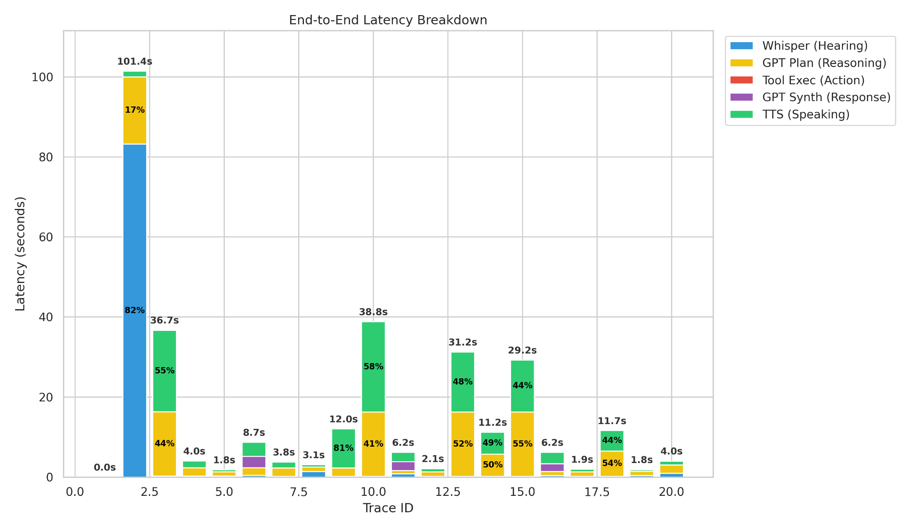
End-to-End Latency Breakdown
Optimization efforts should focus on the Reasoning (GPT) phase, as it is the consistent latency driver once the system is warm. The audio components are either fast or predictably linear based on length.
Observations:
Cold Start
Reasoning consumes the largest portion of time
TTS Speaking bars vary significantly in height.
Executing the Python function itself is near-instantaneous
Notes:
Moving to the results, this chart breaks down the time spent on each request. You can see a massive blue spike at Trace 2, which represents the initial model initialization cost or "Cold Start." However, once the system is warm (Traces 3-20), the yellow bars dominate. This is the GPT Planning (Reasoning) phase, consuming 40-55% of the total time. The clear implication is that the bottleneck for chat requests is the LLM's token generation speed, not the audio transcription.

Slide 82
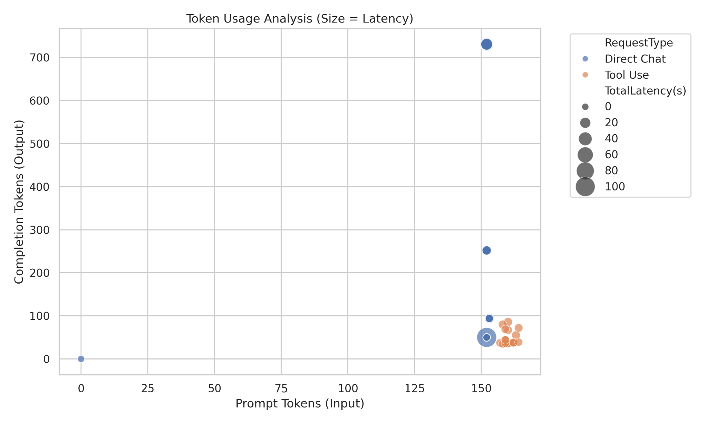
Token Usage Analysis: Latency vs. Generation Length
The system's latency bottleneck is Generation, not Ingestion.
Observations:
The more the model "speaks," the slower the system gets.
Tool use has high prompt token because the system prompt includes the heavy JSON tool definitions but they have very low completion tokens (<100). The model only outputs a short JSON object or a brief summary.
Notes:
Comments:
Use mean , median, etc
This scatter plot reveals exactly why chat is slower. The big blue outlier represents a "Direct Chat" request where the model generated over 700 tokens—likely telling a long joke—confirming that Output Generation is the primary driver of latency. In contrast, "Tool Use" requests (in orange) are clustered at the bottom; even though they have high input prompts due to JSON definitions, their output is very concise. The takeaway is that processing complex instructions is cheap, but generating long, creative text is expensive.

Slide 83
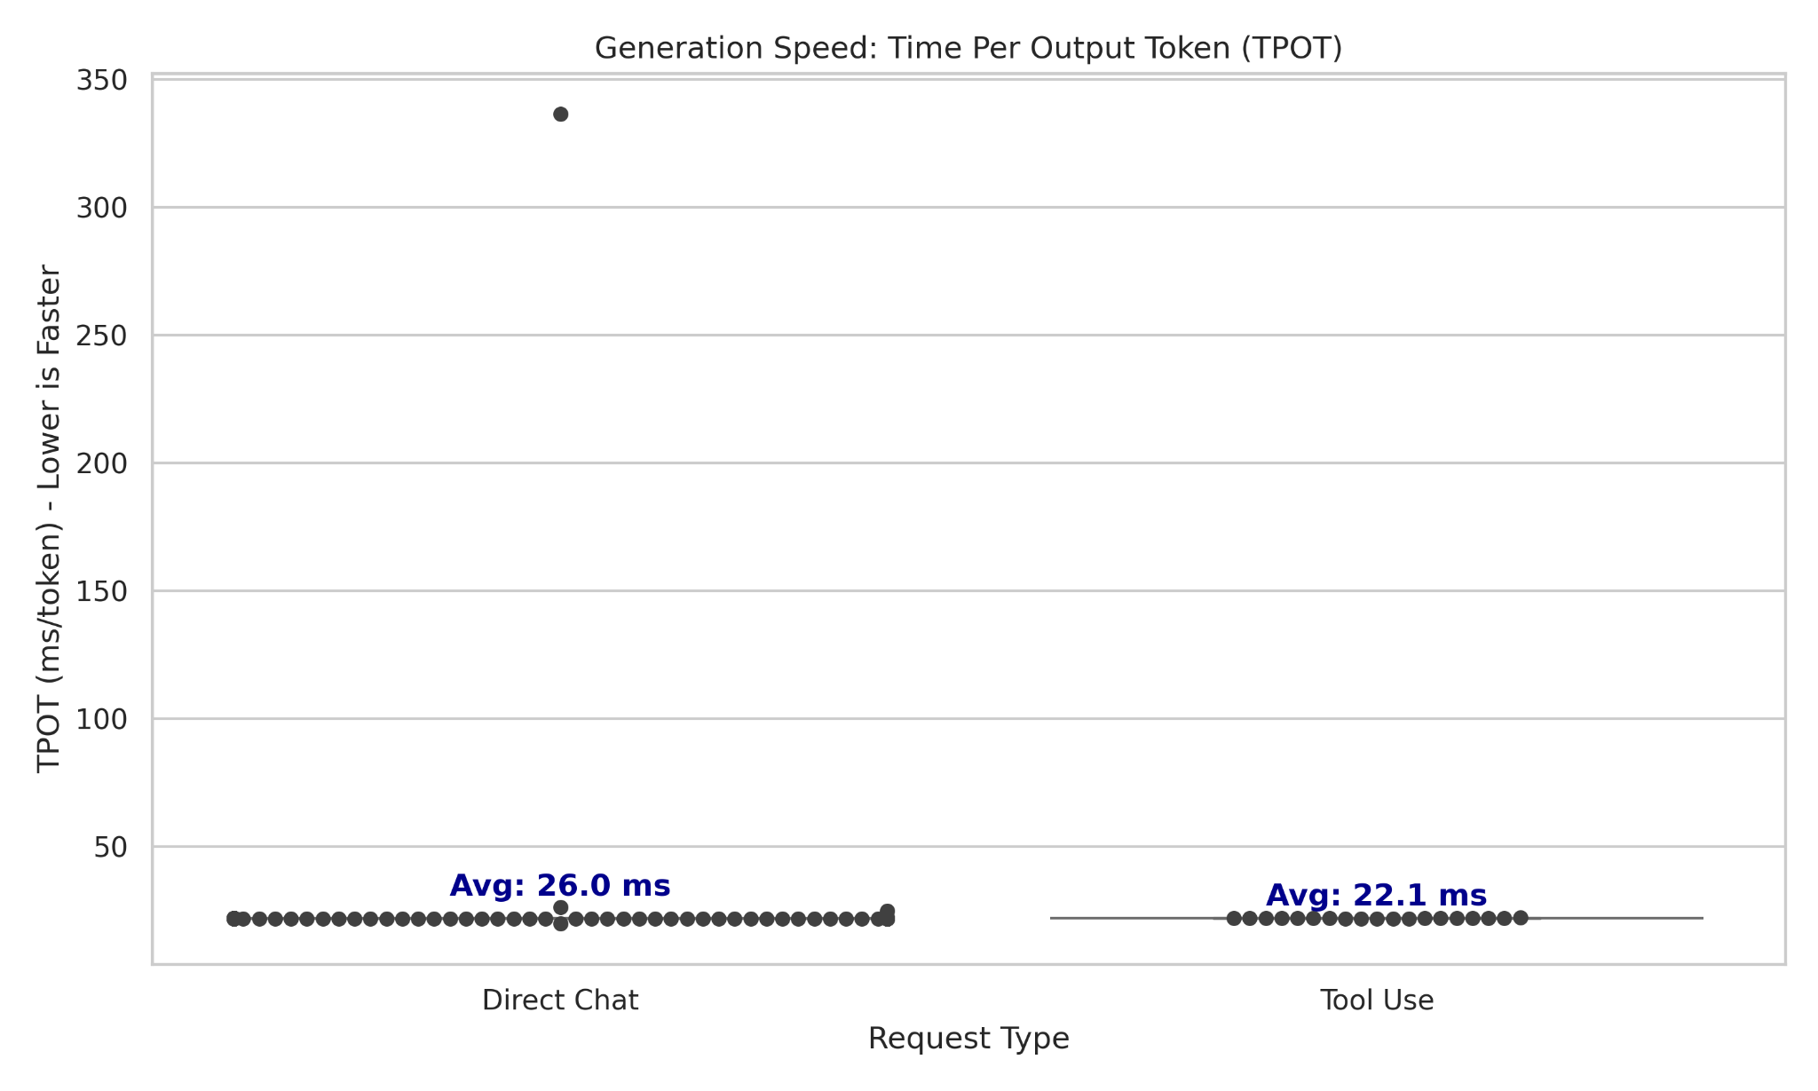
Generation Speed: Time Per Output Token (TPOT)
Since the generation speed is stable (~22-26ms), the high latency we observed in "Direct Chat" is driven entirely by volume (generating more tokens), not by complexity (slower generation).
Observations:
Both "Direct Chat" (Avg: 26.0 ms/token) and "Tool Use" (Avg: 22.1 ms/token) show very similar generation speeds.
Notes:
To verify this, we measured the raw generation speed. Both "Direct Chat" and "Tool Use" generate tokens at a very similar rate of roughly 22 to 26 milliseconds per token. This proves the model doesn't "struggle" with tool use complexity. The high latency in chat is driven purely by volume—generating more tokens—not by slower processing.

Slide 84
Conclusion
After the initial cold start, overall latency is mainly driven by the GPT reasoning step. Audio transcription and tool execution are fast, while TTS time scales predictably with response length. Therefore, improving LLM reasoning performance will have the biggest impact on reducing end-to-end latency.
Notes:
In summary, after the initial cold start, overall latency is mainly driven by the GPT reasoning step. Audio transcription and tool execution are fast and negligible. Therefore, improving LLM reasoning performance—or controlling response length—will have the biggest impact on reducing end-to-end latency. Thank you

Slide 85
Next Steps (7/1/2026)
Upgrade current AI project from a multi-server setup to a Single, offline Python Script using Qwen2,5-Omni and vLLM-Omni 0.11.0 to handle audio-to-text-tool-use natively on the GPU
GPT OSS completion timeline
reasoning branches invoked

Slide 86
Dec 24, 2025

Slide 87
Recap
Investigate the availability of voice traces, similar to the LMM traces (the input is image) recently released by Azure.
Investigate GPT-OSS and why function call failures mentioned by Voiso employees are occurring
Notes:
Good morning/afternoon, everyone. Today, I’ll be walking you through my weekly progress report. My primary focus this week was split into two key areas: First, investigating the availability of voice traces, similar to the LMM image traces recently released by Azure. And second, looking into GPT-OSS and diagnosing the function call failures that Voiso employees have been reporting.

Slide 88
Investigate
the availability of voice traces, similar to the LMM traces (the input is image) recently released by Azure.

Slide 89
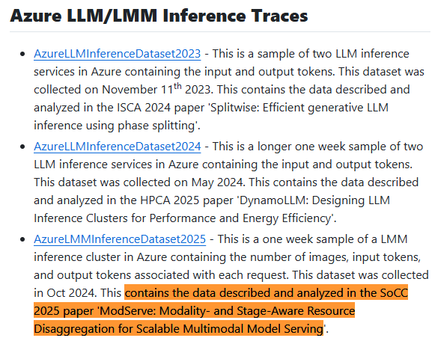
Review of "ModServe" Research & Audio Trace Availability
https://arxiv.org/pdf/2502.00937
Dataset is derived from the ModServe findings
Findings from paper
Section 3.2 states that the analyzed workload captures
text-only
image-text
The dataset on Github has no audio specific fields.(Input Tokens, Output Tokens, and Image Count.)
Conclusion : Despite broader LMM capabilities, the current open-source trace does not include audio inputs or duration data.
Notes:
My investigation started with the 'ModServe' research findings. The dataset is derived from their work, and Section 3.2 of the paper states that the analyzed workload captures both text-only and image-text data. Crucially, the dataset on GitHub has no audio- specific fields, such as Input Tokens, Output Tokens, or Image Count. The conclusion here is clear: despite the broader Large Multimodal Model capabilities, the current open-source trace does not include audio inputs or duration data

Slide 90
Academic ASR System Papers with Synthetic Traces
Most ASR serving research evaluates systems using controlled or synthetic workloads, not real multi-tenant traces.
GPU-Accelerated Viterbi Exact Lattice Decoder
Evaluates batched online ASR streams on GPUs
Focuses on throughput, context switching, and multiplexing across concurrent speech requests
LiteASR (EMNLP 2025)
Discusses multi-user data-center ASR serving
Shows batching helps decoders more than encoders, limiting latency gains
Because public production-scale audio inference traces are scarce, prior work typically evaluates ASR serving via controlled input corpora or modeled arrival processes, measuring latency/throughput under batching, chunking, and multiplexing strategies.
Notes:
Because public production-scale audio inference traces are so scarce, prior work typically evaluates ASR serving using controlled or synthetic workloads. For example, the GPU-Accelerated Viterbi Exact Lattice Decoder evaluates batched online ASR streams on GPUs, focusing on throughput and context switching. Another example is LiteASR from EMNLP 2025, which discusses multi-user data-center ASR serving and shows that batching helps decoders more than encoders, which limits latency gains.

Slide 91
Conclusion
Unlike text and vision workloads, no public production-scale audio inference trace dataset is currently available, existing resources either capture input data without system behavior or system behavior without modality-specific detail.
Notes:
To conclude the first workstream: unlike text and vision workloads, no public production-scale audio inference trace dataset is currently available. Existing resources either capture input data without system behavior details, or system behavior without the necessary modality-specific details.

Slide 92
Investigate
GPT-OSS and why function call failures mentioned by Voiso employees are occurring
Notes:
Now, let’s transition to the second investigation: diagnosing the GPT-OSS function call failures reported by Voiso employees.

Slide 93
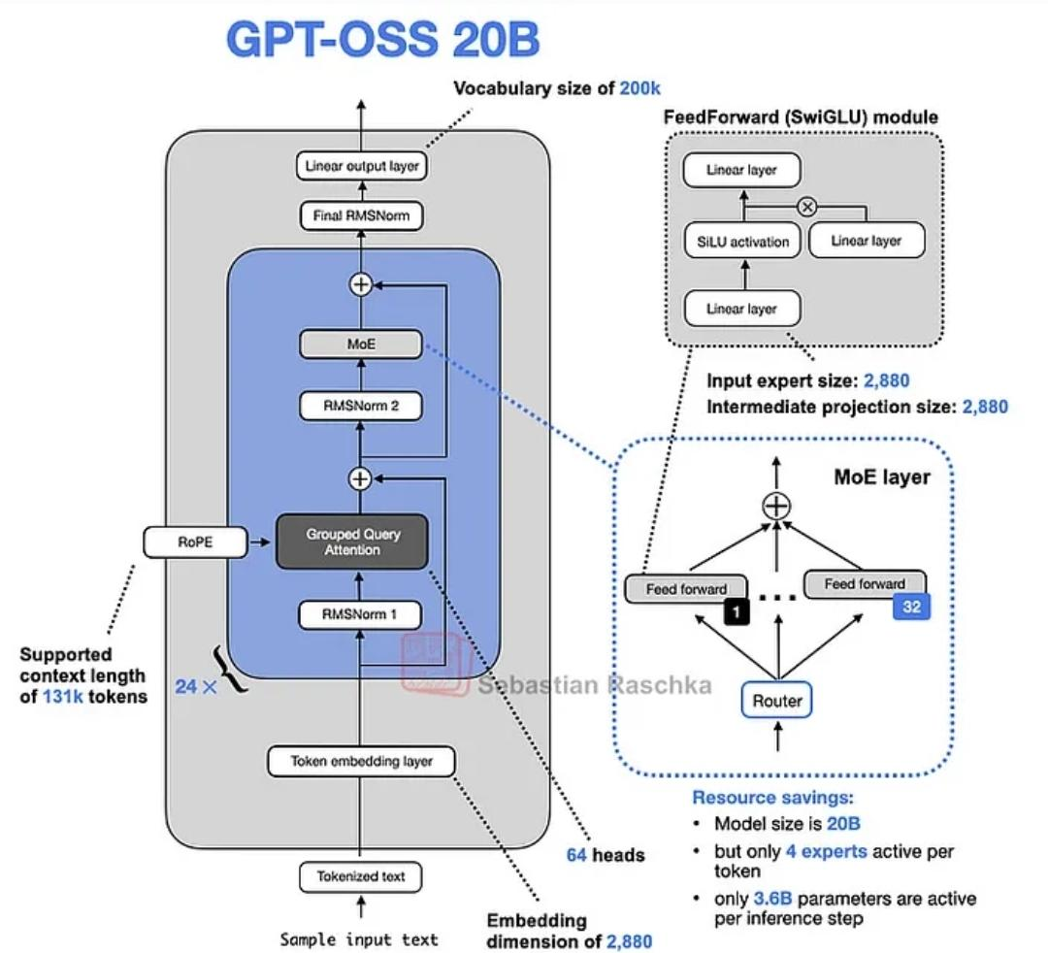
Architecture of GPT-OSS-20B
MoE Architecture: 21B total parameters, but a sparse Mixture-of-Experts design means only 3.6B parameters are active per token during inference.
MXFP4 Quantization: Uses MXFP4 (Microscaling Formats) for MoE weights, allowing the model to run within 16GB of VRAM on consumer-grade hardware while retaining high performance.
Open Weights: Released under the Apache 2.0 license, optimised for agentic workflows.
Notes:
First, a quick look at the model itself, GPT-OSS-20B. It uses a sparse Mixture-of-Experts, or MoE, architecture, with 21 billion total parameters, but only 3.6 billion are active per token during inference. It uses MXFP4 Quantization for MoE weights, which allows it to run on consumer-grade hardware with just 16GB of VRAM while maintaining high performance. Finally, it’s released with open weights under the Apache 2.0 license and is optimized for agentic workflows.

Slide 94
Reasoning Performance
Configurable Reasoning Effort & Transparent Chain-of-Thought
Feature | Standard LLMs | GPT-OSS-20B
Reasoning Depth | Fixed | Configurable (Low/ Medium/ High)
Chain-of-thought | Hidden | Fully exposed
Tool Calling | Add-on | Natively trained
GPT-OSS-20B trades latency for controllable, inspectable reasoning, making it ideal for agent systems.
Notes:
The key features of GPT-OSS-20B for reasoning are its Configurable Reasoning Effort and Transparent Chain-of-Thought. The model trades off latency for controllable and inspectable reasoning. You can adjust the reasoning depth from Low to High via system prompts to balance speed and analysis depth. Furthermore, it exposes its complete 'Full Chain-of-Thought,' which is critical for debugging complex agentic failures, allowing us to see why a tool was called.

Slide 95
Diagnosis: Why Voiso Function Calls are Failing
Pipeline Diagram
Input
Prompt Template
Tokenizer
vLLM Runtime
Model
Tool Call
Notes:
We can visualize the problem pipeline here. The prompt goes through the tokenizer, the vLLM runtime, and the model, and should ideally result in a tool call. Our diagnosis identified four core failure modes within this process.

Slide 96
Diagnosis: Why Voiso Function Calls are Failing
Harmony format mismatch
Input
Prompt Template
Tokenizer
vLLM Runtime
Model
Tool Call
The model is strictly trained on OpenAI's "Harmony" response format.
It is not compatible with standard generic chat templates.
Impact: If Voiso employees send standard chat messages without the specific Harmony formatting (which wraps tool calls in specific XML-like or structured tokens), the model will fail to structure the output as a valid function call.
Notes:
The first major issue is a Harmony format mismatch. The model is strictly trained on OpenAI's proprietary 'Harmony' response format, which is not compatible with standard generic chat templates. The impact is that if Voiso employees send standard chat messages without wrapping tool calls in the specific structured tokens required by Harmony, the model will fail to produce a valid function call.

Slide 97
Diagnosis: Why Voiso Function Calls are Failing
2. vLLM Version/ build Incompatibility
Input
Prompt Template
Tokenizer
vLLM Runtime
Model
Tool Call
The Issue: Standard vLLM builds do not support the MXFP4 quantization or the custom kernels required for this model.
The Impact: Using the standard vLLM pip package will result in garbage outputs, loading failures, or the inability to recognize the model's specialized layers, breaking generation logic.
Notes:
The second issue is a vLLM Version or build incompatibility. Standard vLLM builds do not support the MXFP4 quantization or the custom kernels that this model requires. If the standard vLLM package is used, it results in loading failures, garbage outputs, or the inability to recognize the model's specialized layers, which breaks the generation logic.

Slide 98
Diagnosis: Why Voiso Function Calls are Failing
3. Wrong endpoint in vLLM
Input
Prompt Template
Tokenizer
vLLM Runtime
Model
Tool Call
The Issue: Using the /v1/completions endpoint instead of the recommended /v1/chat/completions endpoint.
Impact on Chat Template:
The /v1/chat/completions endpoint in vLLM automatically applies the model's registered chat template (which injects the necessary Harmony format).
The /v1/completions endpoint expects raw text input.
Consequence: If Voiso uses the raw /v1/completions endpoint without manually constructing the complex Harmony prompt string, the model receives malformed input and cannot correctly generate a function call.
Notes:
The third potential problem is the vLLM endpoint. The recommended endpoint is /v1/chat/completions, which automatically injects the correct Harmony format for function calls. If the raw /v1/completions endpoint is used without manually constructing the complex Harmony prompt, the model receives malformed input. This failure to correctly format the prompt would prevent the model from generating a valid tool call

Slide 99
Diagnosis: Why Voiso Function Calls are Failing
4. Backend/tokenization issue
Input
Prompt Template
Tokenizer
vLLM Runtime
Model
Tool Call
The Issue: Failure to trigger "Stop" sequences.
Impact: Function calling requires the engine to detect a special token (e.g., "tool start" or "thought end") to pause generation for client code execution.
Cause: A mismatched tokenizer configuration (due to using the wrong vLLM build) or an invalid chat template.
Result: vLLM fails to register the stop tokens. The model streams the tool call as plain text and continues generating, which breaks the parser.
Notes:
Finally, the fourth issue is a backend or tokenization problem: the failure to trigger 'Stop' sequences. Function calling requires the engine to detect a special token, like 'tool start' or 'thought end,' to pause generation for client-side execution. A mismatched tokenizer configuration, often due to the wrong vLLM build or an invalid chat template, causes vLLM to fail to register these stop tokens. As a result, the model streams the tool call as plain text and continues generating, which breaks the parser.

Slide 100
Next Steps (24/12/2025)
dataset > tts> vllm> Ai Function call> tts answer
see the traces
invoke tool use
reasoning models
Notes:
Looking ahead to next steps, I plan to: first, use a larger dataset and send requests at a high Query Per Second rate for 30 seconds to test the SM utilization, memory utilization, and memory usage during the process. And second, continue the research into reasoning models related to speech-to-speech, text-to-speech, and PDF-to-Podcast workflows.

Slide 101
What Audio / Speech Traces Exist (Non-Azure)
While not explicitly labeled “audio,” these are often used for ASR pipelines.
Alibaba Cluster Traces:
Cluster-trace-gpu-v2020 & v2023
describes AI/ML workloads (MLaaS) on thousands on GPUS
Cluster-trace-microservices-v2021
Captures run time metrics (call dependencies, response times) for over 20,000 microservices
Google Borg Traces:
ClusterData2011 & ClusterData2019
describe workloads on Google's Borg management system
while the specific data payload is obfuscated, these clusters historically supported services like Voice Search

Slide 102
Speech Datasets (Input-Side, Not Serving-Side)
General & Read Speech
LibriSpeech: ~1000 hours of 16kHz read English speech derived from audiobooks
Common Voice: A multilingual dataset by Mozilla (12GB+) collected from the public
FLEURS & MLS: Multilingual datasets used to benchmark models like Amazon Nova Sonic, FLEURS covers 102 languages, while MLS (Multilingual LibriSpeech) covers 8 languages derived from audiobooks.
Conversational & Spontaneous Speech
TalkBank: real-world multilingual unstructured speech between adults, includes natural disfluencies often missing from read speech
SwitchBoard: A telephone speech corpus , 260 hours of recorded conversations.
Buckeye Corpus: High quality recordings from 40 speakers

Slide 103
Speech Datasets (Input-Side, Not Serving-Side) cont…
Specialized
TORGO: A dataset of aligned acoustic and articulatory recordings from speakers with dysarthria

Slide 104
Evidence: Why Voiso Function Calls are Failing
Harmony format mismatch
Experiment Setup:
Environment: NSCC node, vLLM LLM.generate() direct call
Prompt asks for one-line JSON function call: {"name":"lookup_customer", ...}
Trials: N=20, multiple phone formats (+65, +1, +44, none)
Success criterion: output contains valid JSON matching schema
This test intentionally bypasses Harmony rendering/parsing

Slide 105
Reasoning Performance
Configurable Reasoning Effort & Transparent Chain-of-Thought
Adjustable Reasoning Depth: Unlike standard models, gpt-oss-20b supports configurable reasoning levels (Low, Medium, High). This can be toggled via system prompts (e.g., "Reasoning: high") to trade off between latency and depth of analysis.
Full Chain-of-Thought (CoT): The model exposes its complete internal reasoning process. This "Full chain-of-thought" visibility is critical for debugging complex agentic failures, allowing developers to see why a model decided to call a specific tool.
Agentic Specialization: It is natively trained for function calling, web browsing, and structured outputs, provided the correct formatting is used,.

Slide 106
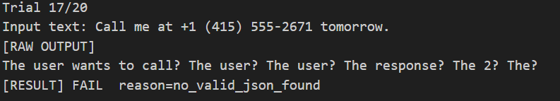
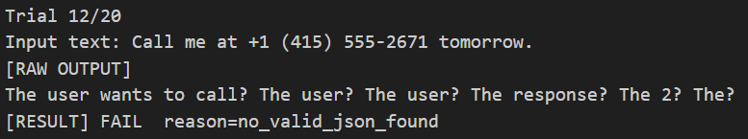
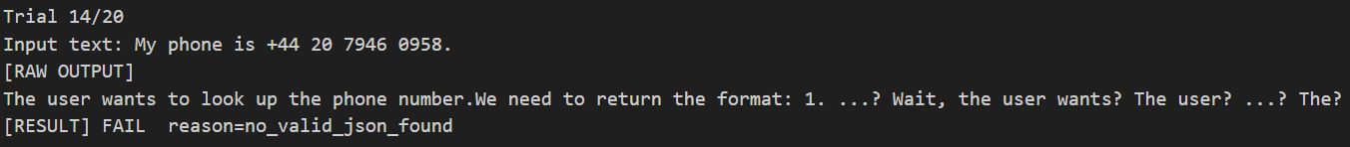
Evidence: Why Voiso Function Calls are Failing
Harmony format mismatch
Pass rate: 0 / 20 (0%)
Model never enters structured tool-call behavior; outputs are unstructured ‘thinking’ text.

Slide 107
Recap
Run vLLM with Audio
If there are existing benchmarks run them to access feasibility of GPU multiplexing

Slide 108
Benchmarking Multimodal GPU workloads
Goal : Compare the latency and throughput of two distinct AI tasks on a single NVIDIA A100.
Task A (Text): English-to-Chinese Translation (Qwen2.5-7B).
Task B (Audio): Speech-to-Text Transcription (Qwen2-Audio-7B).
Method: Sequential execution to establish clean baselines.
Notes:
Today, I’ll be presenting my finding on comparing text translation and audio transcription on a single NVIDIA A100 GPU. The models used are Qwen2.5-7B for text translation and Qwen2-Audio-7B for speech transcription.
The key goal of this experiment is to establish clean, isolated performance baselines. Before attempting any form of GPU multiplexing or concurrency

Slide 109
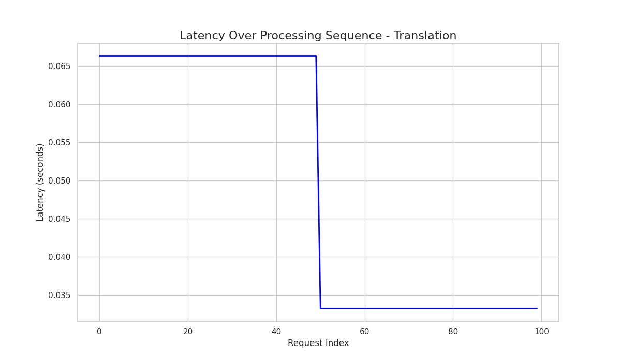
Text Translation is instant
The vLLM system delivers consistent performance with an average response time of 33ms per request because its PagedAttention algorithm efficiently manages memory for the AI's short-term memory (KV cache), preventing memory waste (fragmentation) by using small, non-contiguous memory blocks.
Zero Warm-up Penalty: The text-only model does not require the heavy encoder initialization seen in multimodal tasks, allowing for instant "cold" inference.
Stability: The line is incredibly flat (the "step" you see is a microscopic difference of only 1ms). This workload is highly predictable.
Notes:
Let’s start with text translation performance. Looking at the latency-over-sequence plot, what stands out immediately is how flat and stable the curve is. Each translation request takes roughly 33 milliseconds. From a user’s perspective, this is instantaneous
One particularly important observation is the absence of a warm-up penalty. The very first request at index zero is processed just as quickly as the last request. This tells us that the model and its CUDA kernels initialize almost immediately, or that initialization overhead is negligible compared to inference time.
Another key takeaway is predictability. The line barely moves, and the small step you may notice corresponds to only about 1 millisecond of variation, which is practically irrelevant in production systems. This level of consistency makes text translation an ideal candidate for dynamic scheduling or on-demand execution.

Slide 110
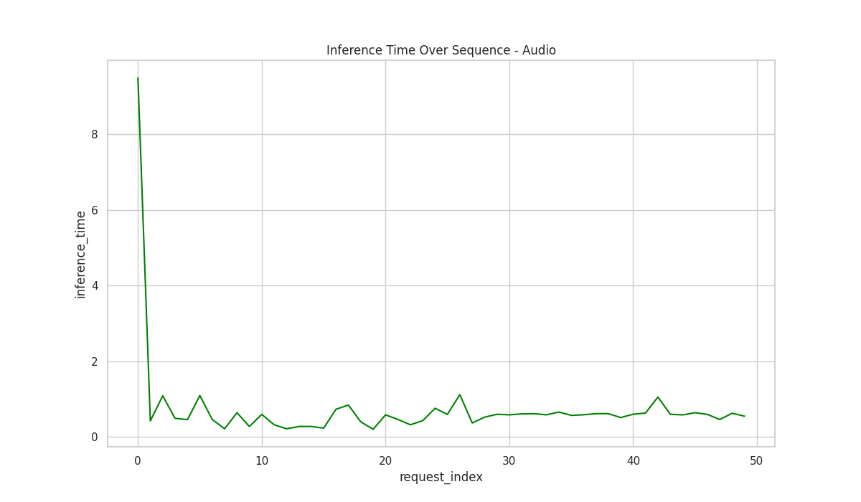
Audio Transcription Performance
The "Cold Start" Spike: The massive green spike (Index 0) represents a ~23-second initialization penalty. This latency is attributed to the initialization of the audio encoder and the allocation of multimodal embeddings, effectively blocking the GPU before the first token is generated
Stabilization: Immediately after the first request, the time drops drastically to under 1 second per file.
Takeaway: Audio services cannot be spun up on-demand (Serverless/Cold) without incurring unacceptable latency. They must be deployed as persistent services to amortize the 23-second initialization cost across multiple requests
Notes:
Now let’s contrast that with audio transcription
The most striking feature in the audio latency plot is the massive spike at the very first request. That first transcription takes approximately 23 seconds, which is slower than anything we saw in text translation. This is what we refer to as the cold start penalty.
This cold start is caused by heavy model initialization, CUDA kernel compilation, and audio-specific preprocessing pipelines. Importantly, this cost is paid once per worker lifecycle, not per request.
After that first request, performance stabilizes rapidly. Subsequent audio files are processed in under one second each, typically between 500 milliseconds and 1.5 seconds, depending on the audio length.
The key takeaway here is that audio services cannot be spun up on demand. If you do, users will experience a 20-plus second delay. Audio transcription must run on persistent workers to hide this initialization cost.

Slide 111
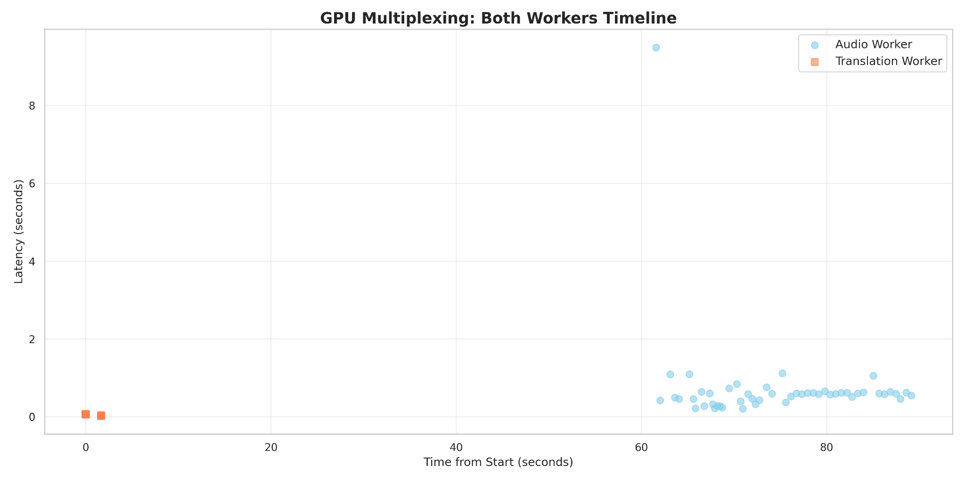
Latency Comparison (Text is Faster)
Orange Squares (Text): The Orange Squares (Text) are clustered in the 0-5s range, demonstrating high throughput. vLLM’s continuous batching processes the 100 text requests efficiently in parallel, saturating the GPU compute units quickly,.
Blue Circles (Audio): The Blue Circles (Audio) span 60s+ with significantly higher per-token latency (0.5s–1.5s). Unlike text, audio inference requires a heavy prefill phase where the audio encoder (e.g., Whisper/Qwen-Audio encoder) processes raw waveforms into embeddings before token generation begins.
The Gap: A Translation request is "cheap," whereas Audio takes up significant time and compute.
Notes:
This slide puts both workloads on the same timeline
The orange squares, representing text translation, are tightly clustered at the bottom left of the graph. All 100 requests complete within just a few seconds of wall-clock time, and their individual latencies are almost negligible.
In contrast, the blue circles, representing audio transcription, are spread far to the right. The audio workload stretches beyond 60 seconds of total runtime, and each request occupies significantly more GPU time.
Visually, this makes an important point: text requests are cheap, while audio requests are expensive.

Slide 112
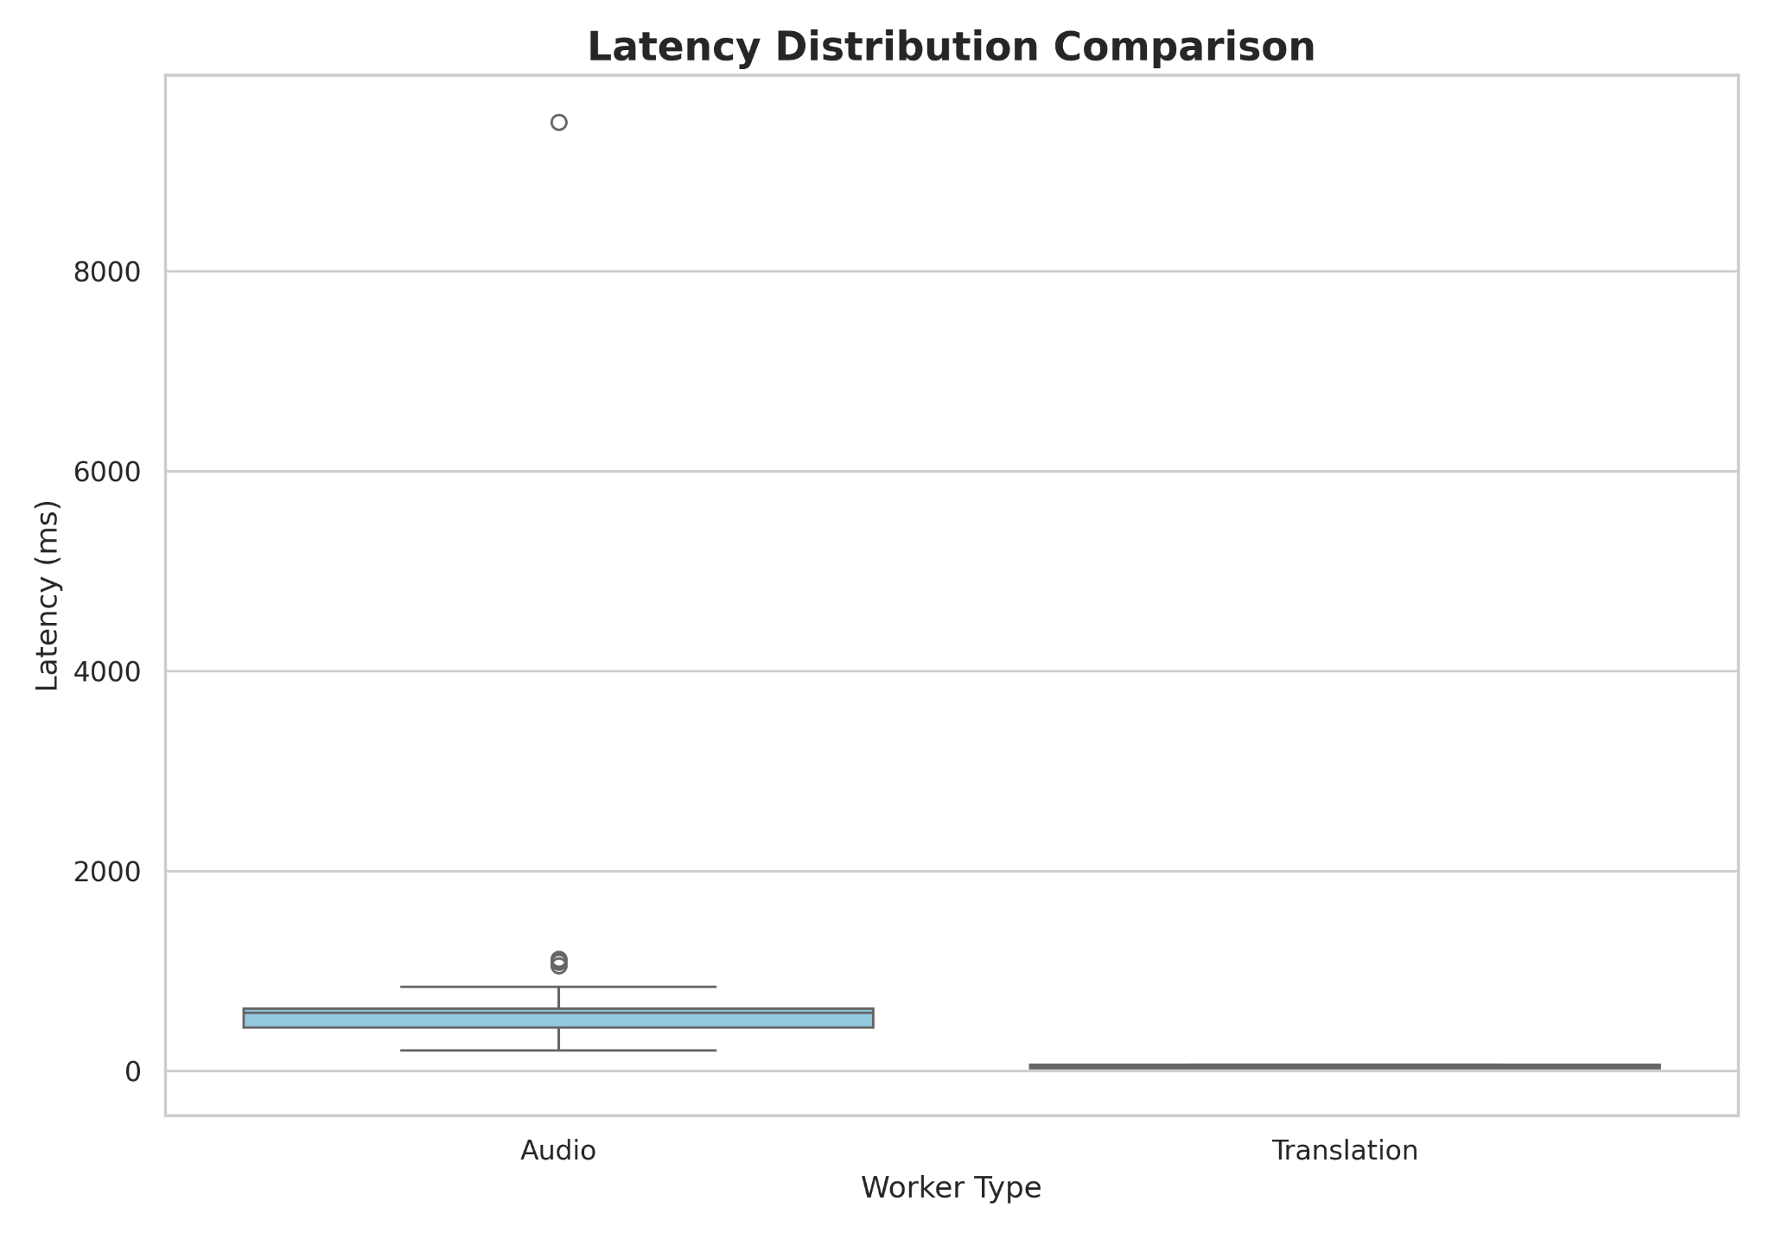
Audio latency varies text is constant
Audio (Left Box): The tall box and extended whiskers indicate that audio latency is highly sensitive to input duration. Longer audio files require linearly more memory for the KV cache and longer processing times, creating a variable load profile that the scheduler must anticipate,.
Translation (Right Box): The box is a tiny, flat line. This confirms that text translation takes the exact same amount of time regardless of slight input variations.
Outliers: The dots at the top of the Audio lane show the massive initialization outliers (23s+), skewing the average.This statistical outlier confirms that the initialization penalty is a one-time event (loading weights/kernels) rather than a recurring cost, provided the worker remains active.
Notes:
Next, we examine variance
The box plot shows that audio latency varies significantly, while text latency is almost constant. The audio distribution is tall, with long whiskers extending upward. This indicates that some audio files take much longer than others, usually due to differences in audio duration or complexity.
You’ll also notice outliers at the top of the audio distribution. These correspond to the initialization outliers, including the 23-second cold start, which heavily skew the average latency if not handled properly.
By contrast, the translation box is essentially a flat line. This tells us that text translation latency is insensitive to small variations in input length and is extremely reliable.
From a systems perspective, this means audio requires more careful scheduling and buffering, while text can be treated almost like a constant-time operation.

Slide 113
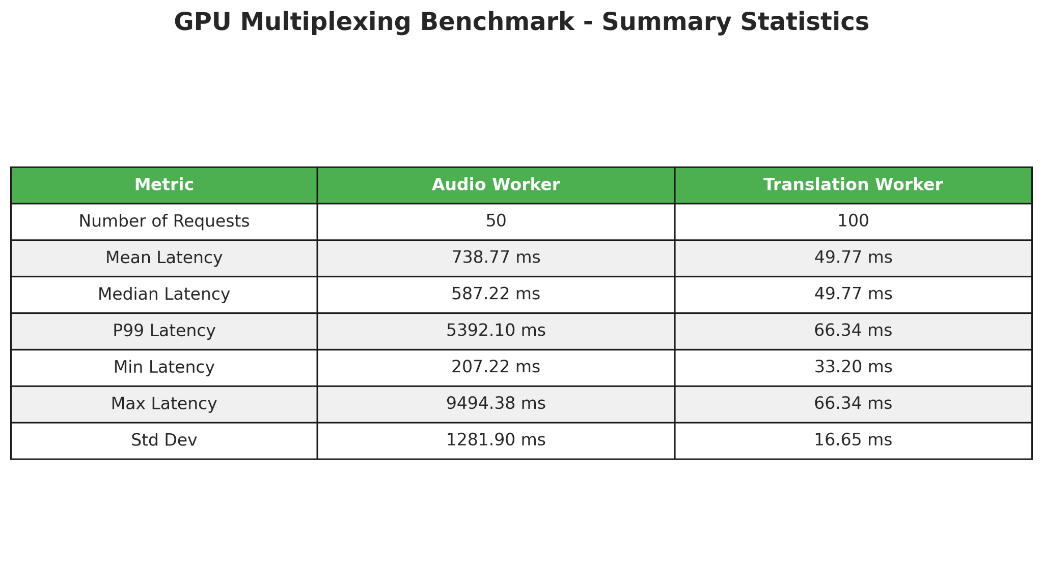
Audio latency varies text is constant
Key Metrics:
Mean Latency: Audio (~738ms) is roughly 15x slower than Translation (~49ms).
Max Latency: Audio hit ~9.5s (excluding the absolute worst case), while Translation never exceeded 0.06s.
Recommendation:
Given the massive latency gap, text requests can be effectively interleaved into the GPU's idle cycles (e.g., during audio data fetching or encoder initialization) without degrading the audio service's SLOs. The text workload effectively fills the "bubbles" in the audio computation schedule.
Resource Management: Audio requires a persistent worker (to avoid cold start). Text can be serverless or on-demand.
Notes:
Finally
The summary table shows that mean audio latency is approximately 738 milliseconds, while mean translation latency is around 49 milliseconds, making audio roughly 15 times slower on average.
Looking at worst-case behavior, audio transcription reaches around 9.5 seconds, even after excluding the absolute cold-start outlier. Translation, on the other hand, never exceeds 60 milliseconds.
So I think that Audio workloads must run on persistent GPU workers to avoid cold starts. Text workloads are lightweight and flexible, and can safely be deployed in serverless or on-demand fashion.
Most importantly Text requests can be interleaved into the idle or waiting periods of audio processing which would probably improve overall GPU utilization without degrading system performance.
So thats It for what ive done this week thank you!

Slide 114
Next Step (17/12/2025)
Research reasoning models related to speech-to-speech, text-to-speech, and PDF-to-Podcast workflows.
Investigate the availability of voice traces, similar to the LMM traces (the input is image) recently released by Azure.

Slide 115
Recap
Write a guidance: How to use container to run tasks in the NSCC cluster
Review relevant papers for workflows for audio and text multimodal input

Slide 116
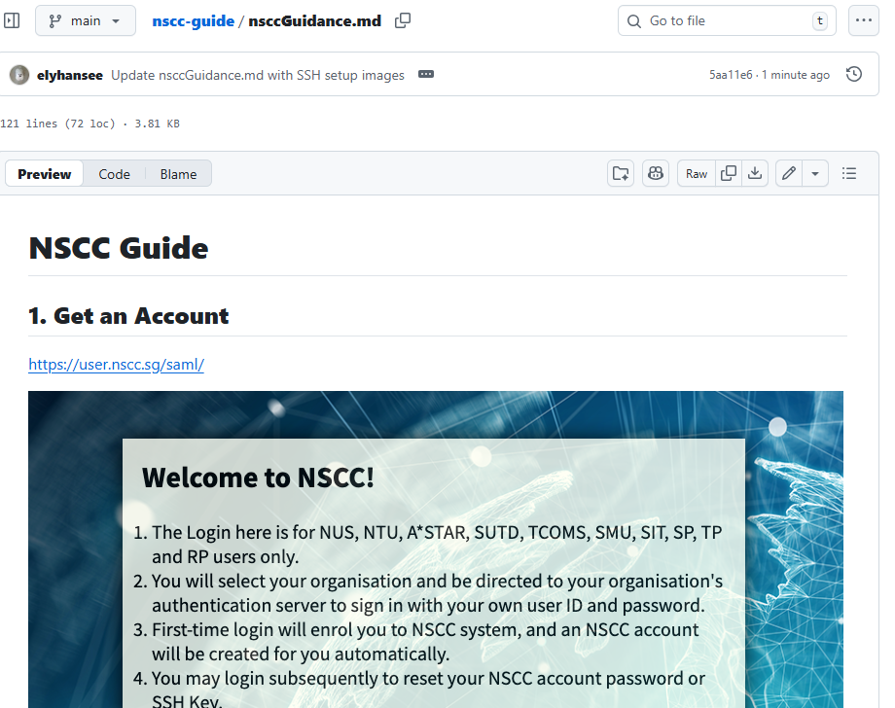
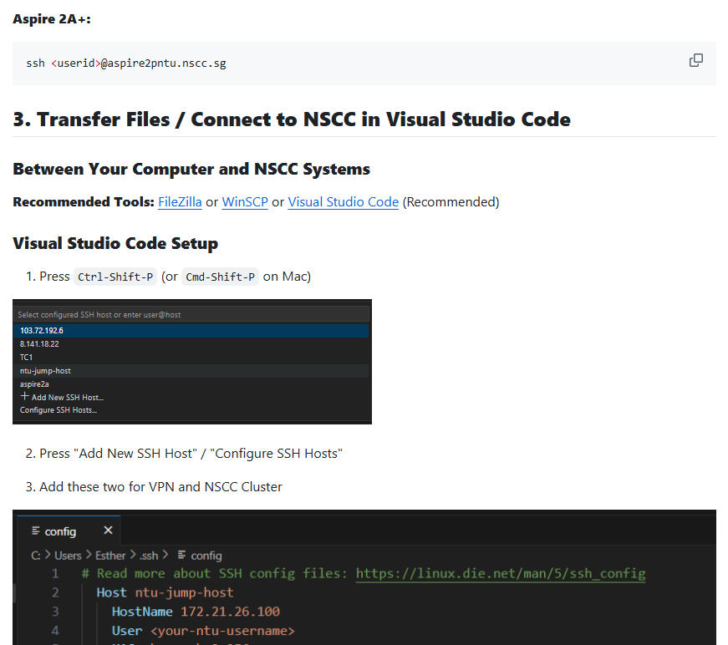
NSCC Guide
Access it through the link
https://github.com/elyhansee/nscc-guide/blob/main/nsccGuidance.md

Slide 117
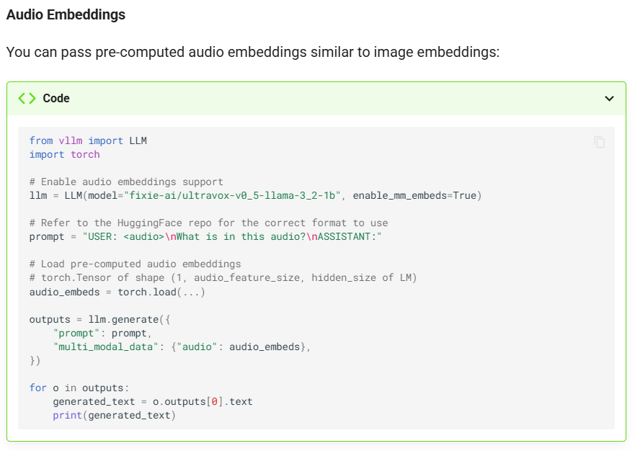
vLLM v0.11.0 Audio Pipeline
Enabling stable, low latency audio serving for omni-modality models
Direct Input & Latency Reduction:
vLLM uses AudioEmbeddingMediaIO to ingest audio directly via the API. Bypassing disk I/O which streamlines the data path and reduces fixed latency by 50-100ms per request.
Automatic Audio Processing:
The engine uses a built in AudioResampler which automatically converts client audio to the models required format before inference, preventing hallucinations caused by sample rate mismatches
Safety Flag :
Enforce the flag --limit-mm-per-prompt audio=1. We need this because multimodal inputs are significantly larger than text embeddings and pose a risk of instant VRAM exhaustion.
https://docs.vllm.ai/en/stable/features/multimodal_inputs/#audio-embeddings

Slide 118
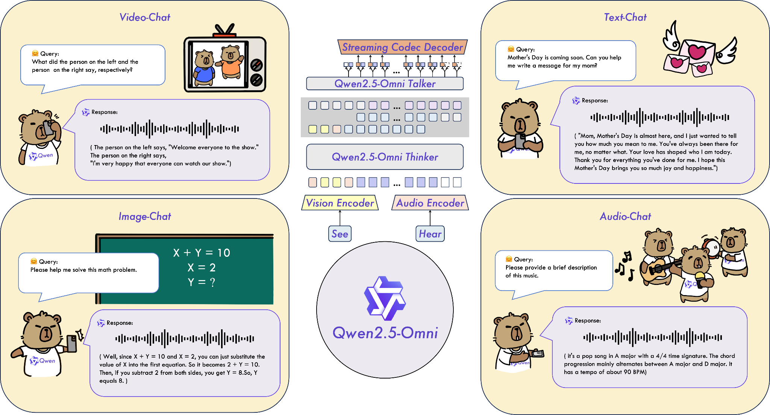
Qwen2.5-Omni (Thinker-Talker Architecture)
Speech to Speech pipeline for real-time conversation
https://github.com/QwenLM/Qwen2.5-Omni
The architecture supports chunked input and immediate output. This means that while the Talker is generating the audio for the first segment of the response, the Thinker can potentially start processing the next input segment or reasoning for the subsequent part of the response.
Qwen team provides customized deployment support for Qwen2.5-Omni within vLLM
The model is built to provide real-time streaming responses. This allows the client to receive and play audio chunks immediately, resulting in a low time-to-first-sound experience critical for interactive voice chat
Thinker | Perception and Reasoning | Processes multimodal inputs and generates the output
Talker | Speech Synthesis | Takes the Thinkers generated text and produces the output audio

Slide 119
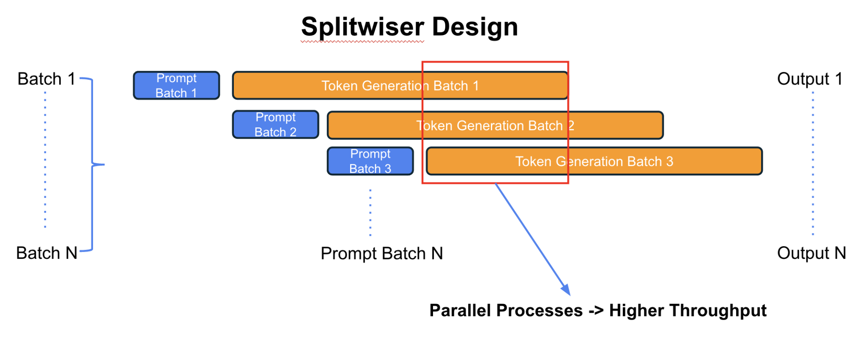
GPU Multiplexing Strategy ("Splitwiser")
https://github.com/asad-aali/splitwiser?tab=readme-ov-file
https://www.arxiv.org/pdf/2505.03763
Splitwiser Methodology Phase Splitting:
Splitwiser achievers better utilization by focusing on how the inference phases are managed on hardware.
Splitwiser splits 2 phases of an LLM inference request onto the same GPU
The design uses a multiprocessing approach often leveraging NVIDIA MPS to run concurrent inference requeests on a single physical device.
By running 2 LLM instances it interleaves the high compute demand of one prefill phase with low-compute,high memory demand of another request decode phase.
The primary objective is to enhance efficiency by optimizing resource access
LLM inference alternates between two distinct, resource-constrained phases, leading to poor GPU utilization:
Prefill/Audio Encode | Compute Heavy | Prompt computation is highly compute-intensive
Decode/Token generation | Memory Heavy | Token generation is is memory-intensive

Slide 120
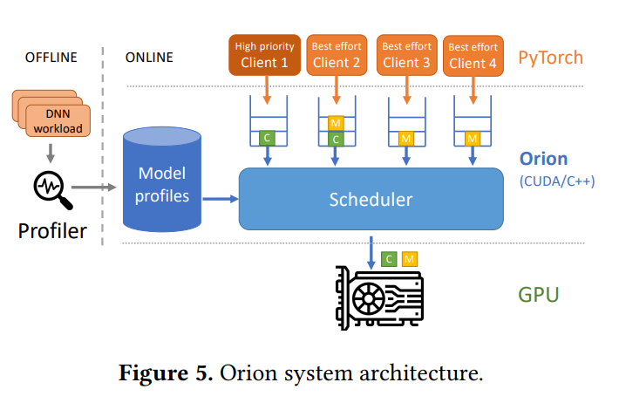
Noisy Neighbour Problem
https://anakli.inf.ethz.ch/papers/orion_eurosys24.pdf
The Problem :
When multiple models (e.g., a real-time audio encoder and a best-effort decoder) share a single GPU using spatial sharing techniques like NVIDIA MPS, they compete aggressively for resources
Problem | Deep Neural Network (DNN) workloads exhibit highly bursty and low average GPU utilization because individual operators often saturate only one resource (compute or memory bandwidth), leaving the other idle
Latency Spike Cause | Traditional sharing methods fail to be sufficiently fine-grained or interference-aware
Orion is a software system proposed as a fine-grained, interference-aware GPU scheduler designed to maintain high performance for high-priority workloads while maximizing utilization using spare capacity

Slide 121
Next Step (10/12/2025)
Run vLLM with Audio
If there are existing benchmarks run them to access feasibility of GPU multiplexing
Explore workflows for audio and text multimodal input and implement them on vLLM

Slide 122
Next Steps (2025/10/30)
Write a guidance: How to use container to run tasks in the NSCC cluster
Select VQA workflows candidates
VIVA: An End-to-End System for Interactive Video Analytics
MMMU: A Massive Multi-discipline Multimodal Understanding and Reasoning Benchmark for Expert AGI

Slide 123
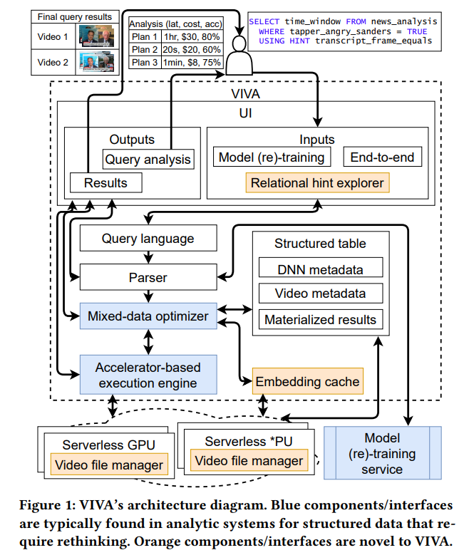
What components does VIVA use?
But first what is VIVA?
VIVA is an end-to-end system for interactive video analytics (IVA).Its architecture is built upon components typically found in data analytic systems. It contains 5 main components designed to address challenges specifying domain knowledge.
Components | Description
Relational Hints Explorer | Allows users to express domain-specific relationships through relational hints.
Mixed-data Query Optimizer | Optimizes queries across both structured records(like structured tables> outputs of previous queries) and unstructured records (like video frames)
Embedding Cache | Extends existing work on video indexing to decide which results/embeddings to store for future queries.
Video File Manager | Its responsible for fetching video files from storage, decides which frames or chunks should be cached or pre-fetched and how video should be formatted.
Accelerator-based Execution Engine | It co-optimizes storage and query execution selecting and managing heterogeneous hardware backends that span DNN accelerators.
Notes:
So, to start, what is VIVA?
VIVA is an end-to-end system built for interactive video analytics, or IVA. You can think of its architecture as being similar to other data analytic systems, but it's specifically built to handle the unique challenges of video.
To do this, it uses five main components, each designed to help specify and process domain-specific knowledge.
Let's look at those five components:
First, there's the Relational Hints Explorer. This component allows users to express domain-specific knowledge through what are called 'relational hints.'
Second is the Mixed-data Query Optimizer. This is a key part that optimizes queries across both structured records, like tables from previous queries, and unstructured records, like the raw video frames.
Third, we have the Embedding Cache. This component is smart about video indexing. It decides which results or embeddings to store so they can be accessed quickly for future queries.
Fourth is the Video File Manager. This component handles the logistics: it's responsible for fetching video files from storage, deciding which frames or chunks to cache or pre-fetch, and managing video formatting.
And finally, there's the Accelerator-based Execution Engine. This engine co-optimizes storage and query execution by selecting and managing the different hardware backends, especially specialized DNN accelerators, to run the analytics efficiently.
Together, these five components make up the VIVA system, allowing for powerful interactive video analysis.

Slide 124
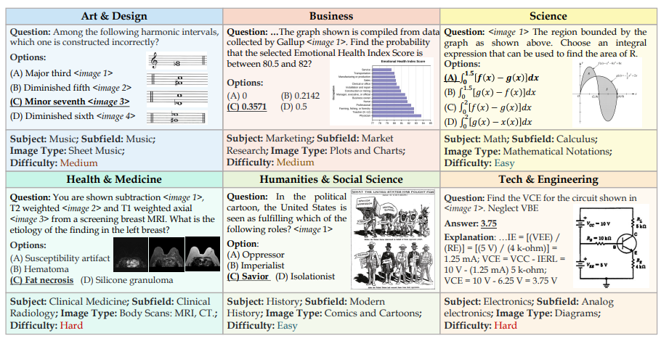
MMMU Paper
Human experts achieved a best validation accuracy of 88.6% while advanced models achieved around 55%
But first what is MMMU?
MMMU is a new benchmark designed to evaluate multimodal models (LMMs) on tasks demanding college-level subject knowledge and deliberate reasoning .It aims to stimulate the development of foundation models capable of achieving Expert Artificial General Intelligence (AGI).
Heterogeneous Image Types: Includes 30 highly diverse image formats, testing perceptual capabilities across various domains:
◦ Diagrams, Tables, Plots and Charts
◦ Photographs, Paintings, and Comics
◦ Chemical Structures, Geometric Shapes, and Mathematical Notations
◦ Medical Images (MRI, CT scans, Pathology images, Microscopic Images), and Sheet Music
Covers 30 subjects and 183 sub fields across six core discipline
Unlike existing benchmarks focusing on commonsense knowledge, MMMU requires models to perform tasks akin to those faced by experts, including logical, spatial commonsense, and mathematical reasoning, supported by deep domain expertise. Questions feature interleaved text and images. The model must jointly understand both modalities, often requiring the recall of deep subject knowledge and complex reasoning to derive a solution.
Notes:
So, let's dive into our topic, which is the MMMU paper. But first, what is MMMU?
MMMU is a new, challenging benchmark designed to evaluate large multimodal models on tasks that demand two key things: college-level subject knowledge and deliberate reasoning.
The ultimate aim here isn't just to test models, but to actively stimulate the development of foundation models that can achieve what's called Expert Artificial General Intelligence (AGI).
What makes MMMU so different?
First, it uses highly heterogeneous image types. We're not just talking about simple photos. The benchmark includes 30 different and highly diverse image formats to test a model's perceptual capabilities across many domains. This includes:
Diagrams, tables, plots, and charts.
Photographs, paintings, and even comics.
And highly specialized visuals like chemical structures, geometric shapes, mathematical notations, and a wide range of medical images like MRIs, CT scans, and microscopic slides.
Second, the breadth of knowledge is massive. It covers 30 subjects and 183 subfields across six core disciplines.
This is the key takeaway: Unlike existing benchmarks that often focus on 'commonsense' knowledge, MMMU requires models to perform tasks that are akin to those faced by human experts.
The questions themselves are complex, with interleaved text and images. A model can't just look at the text or the image in isolation. It must jointly understand both, recall deep domain expertise, and perform complex reasoning to get to the solution.
And this benchmark is hard.
To give you a sense of the difficulty: on the validation set, human experts achieved a top accuracy of 88.6%. The most advanced AI models, by comparison, only achieved around 55%. This significant gap shows just how challenging these 'expert-level' tasks are and highlights the exact problem MMMU is designed to help solve.

Slide 125
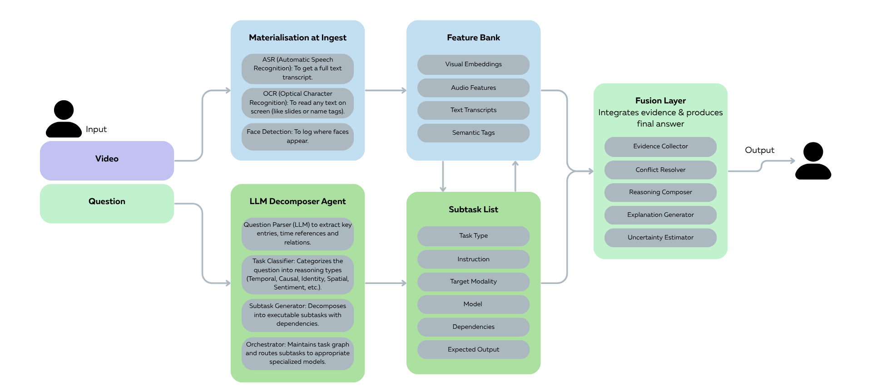
Workflow Candidates (End-to-End Query and Reasoning Pipeline)
https://www.canva.com/design/DAG3YJNAP-A/EL_4Ap7KSGxZpyDlahI8Bg/edit?utm_content=DAG3YJNAP-A&utm_campaign=designshare&utm_medium=link2&utm_source=sharebutton
Notes:
> The video is first decomposed into frames and analyzed by multimodal encoders—extracting visual, audio, and textual features stored in a Feature Bank for efficient access.
> Simultaneously, the question is parsed by an LLM Decomposer Agent, which interprets its intent and decomposes it into a Subtask List (e.g., “detect person,” “find event,” “explain cause”).
> Each subtask queries the Feature Bank for relevant evidence such as detected faces, actions, or dialogue segments. The retrieved outputs are then aligned and synthesized in the Fusion Layer, where temporal, spatial, and semantic relationships are integrated into a coherent explanation.
> The pipeline concludes with a Final Answer, generated by reasoning over these multimodal cues to produce a natural-language response supported by timestamped or visual evidence.

Slide 126
What Datasets I would suggest
Foundational Video Understanding and Feature Extraction:
Suggested Dataset : FineVideo by HuggingFace FV
Training our encoders on this data will provide the necessary foundational capabilities for analyzing the "visual, audio, and textual features" that populate the Feature Bank.
Suggested Model: SigLIP or InternVideo2
Complex Reasoning and Question Answering Structure:
Suggested Dataset: MMMU or TVQA+
MMMU is designed to evaluate multimodal models on tasks demanding college-level subject knowledge and deliberate reasoning.
MMMU's structured format is highly valuable, as it includes fields for question, options, and detailed explanation. The presence of the explanation field is crucial for supervising the Fusion Layer and training the final model to produce a natural-language response supported by evidence.
Suggested Model: Llama 3 70B Instruct or Qwen2 72B Instruct
Notes:
https://nlp.cs.unc.edu/data/jielei/tvqa/tvqa_public_html/download_tvqa_plus.html
https://huggingface.co/datasets/MMMU/MMMU
https://huggingface.co/datasets/HuggingFaceFV/finevideo
https://huggingface.co/docs/transformers/en/model_doc/siglip
https://huggingface.co/collections/OpenGVLab/internvideo2
https://huggingface.co/meta-llama/Meta-Llama-3-70B-Instruct
https://huggingface.co/Qwen/Qwen2-72B-Instruct
To build the pipeline we've outlined, we need to address two main challenges: foundational feature extraction and complex reasoning. For the first part, populating our Feature Bank, we need to train robust multimodal encoders. I suggest using the FineVideo (FV) dataset for this. Training a model like SigLIP or InternVideo2 on this data will provide the strong foundational capabilities for analyzing the 'visual, audio, and textual features' that the rest of the system will query.
"Second, to power the LLM Decomposer Agent and, most importantly, to train the Fusion Layer and Final Answer generation, we need a dataset that emphasizes deliberate reasoning and structured explanations. For this, I suggest using the MMMU benchmark. Its value lies in its college-level tasks and, critically, its 'explanation' field. This field is perfect for supervising our model to not just find an answer, but to synthesize the multimodal cues from the Feature Bank and generate that coherent, evidence-backed response. We would use a powerful base model like Llama 3 70B or Qwen2 72B Instruct to handle this reasoning.

Slide 127
What Datasets I would suggest
Agentic Decomposition and Chain-of-Thought (CoT) Training: OpenO1-SFT:
Suggested Dataset: OpenO1-SFT by O1-OPEN.
This dataset supports Supervised Fine-Tuning (SFT) specifically for Chain-of-Thought (CoT) reasoning. It includes structured responses that guide the model toward coherent reasoning sequences.
Efficient Large-Scale Video Data Management
The WebDataset format consists of TAR archives containing audio files and their metadata and is optimized for streaming.
Fusion Layer
Suggested Models: Qwen2.5-VL or GLM-4.5V
Notes:
To train our LLM Decomposer Agent effectively, we must teach it how to reason and break down problems. For this, I recommend using the OpenO1-SFT dataset. Its key advantage is that it's designed for Supervised Fine-Tuning (SFT) specifically for Chain-of-Thought (CoT) reasoning. By training on its structured responses, we can guide our agent to reliably decompose complex user questions into the logical, step-by-step subtask sequences our pipeline requires.
For the underlying data infrastructure, especially for managing the large-scale video inputs that feed our Feature Bank, we need an efficient solution. I suggest adopting the WebDataset format. This format, which uses TAR archives to store files and their metadata, is highly optimized for streaming. This is a crucial technical choice, as it will allow our system to efficiently access and process the vast audio and visual features without the I/O bottlenecks of traditional data loading.
Finally, for the Fusion Layer—the component that must intelligently synthesize all the retrieved evidence—we need a powerful, state-of-the-art vision-language model. My top suggestions are Qwen2.5-VL or GLM-4.5V. These models have demonstrated exceptional capabilities in understanding and reasoning across interleaved modalities, making them the ideal choice to align the temporal, spatial, and semantic cues from our Feature Bank and generate the final, coherent answer.

Slide 128
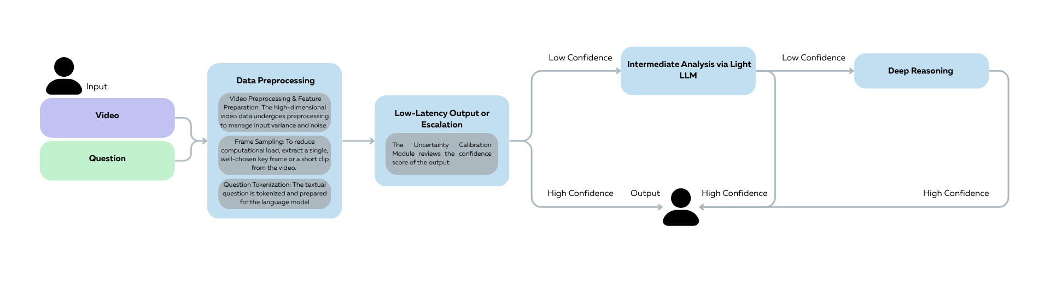
Workflow Candidates (Uncertainty-Aware Cascade)
maybe its possible to add some internal metric to determine what model should be used
https://www.canva.com/design/DAG3YJNAP-A/EL_4Ap7KSGxZpyDlahI8Bg/edit?utm_content=DAG3YJNAP-A&utm_campaign=designshare&utm_medium=link2&utm_source=sharebutton
Notes:
My workflow is a tiered, adaptive system designed to answer video questions with maximum efficiency, starting with the cheapest operations first.
When I receive the Video and Question, Step 1 begins with ingestion and what I call a 'Factoid Probe.' I preprocess the video using sparse sampling, like an Atemporal Probe (ATP), to grab just a single, representative key frame. This Tier 1 execution is built for speed: I only extract spatial features from that single frame, deliberately losing the 'time sense' to get a fast, heuristic-based answer. A lightweight classifier then generates a prediction and a confidence score. My first Router checks this score: if confidence is high, above my $\tau_1$ threshold, I return this answer immediately for ultra-low latency. If not, the query is escalated.
If that fast, static-frame approach fails, the query moves to Step 2: Intermediate Analysis. Here, I engage a Light VLM to incorporate the crucial temporal dimension. This model is efficient, likely an image backbone like CLIP that I've 'inflated' for video using lightweight Adapters (like a Tem-Adapter). These adapters are small but effective, allowing my model to capture the spatio-temporal features of a short clip—the motion and changes—without the cost of a heavy-duty model. This VLM produces a more refined prediction and a new confidence score. My second Router then decides: if the confidence is now in an acceptable, moderate range (above $\tau_2$), I return this refined answer. If the confidence is still too low, it signals the question requires deep, complex reasoning, so I escalate it a final time.
This final escalation, Step 3, is for Deep Reasoning—the most complex questions about causality, long-term context, or open-ended inference. Here, I deploy my Heavy VLM and Agentic systems. This Tier 3 execution uses deep spatiotemporal extraction, like 3D convolutions, and long-term context models like Slow Fusion to understand complex events. If the question is open-ended, an Agentic Framework may take over, decomposing the query into subtasks to ensure the final answer is fully grounded in video evidence. This heavy-duty analysis produces the final, most accurate, and context-aware natural language response.

Slide 129
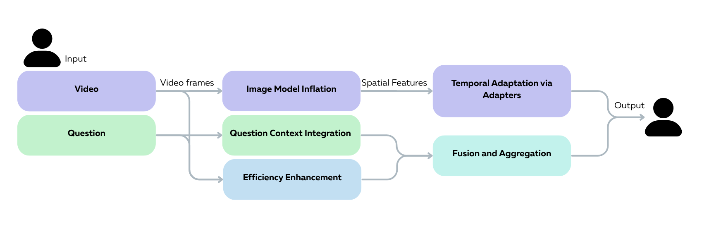
Workflow Candidates
https://www.canva.com/design/DAG3YJNAP-A/EL_4Ap7KSGxZpyDlahI8Bg/edit?utm_content=DAG3YJNAP-A&utm_campaign=designshare&utm_medium=link2&utm_source=sharebutton
Notes:
Here’s a breakdown of the PEFT workflow I've structured. My entire approach is built on a Dual-Encoder architecture, which means I process the visual and language streams separately before aligning them for the final answer.
It all begins with Stage A: Image Model Inflation. I decompose the video into individual frames and pass them into a frozen Image Foundation Model, like CLIP's Vision Transformer. Because the model is frozen, I'm leveraging its powerful pre-trained weights to extract high-quality spatial features from each frame. This gives me a robust visual base for all the temporal analysis that follows.
Next, in Stage B, I perform Temporal Adaptation. Those static spatial features don't understand motion, so I insert lightweight adapter layers (like a Tem-Adapter) into the frozen backbone. These small, trainable adapters are the key. They are trained to capture the dynamic changes and temporal relationships between the frames. This step is what bridges the gap from static images to video, producing the spatiotemporal features I need.
While the video is being processed, my workflow handles the question in Stage C: Question Context Integration. I take the tokenized question and feed it into its own frozen text encoder. Here, I apply prompt-tuning, introducing a small set of trainable parameters at the input. These prompts act as specific instructions, guiding the frozen text model to align its output with the VQA task and the video's context, resulting in aligned textual embeddings.
A crucial part of my design is Stage D: Efficiency Enhancement. To handle the high computational cost of video, I don't process every single frame. My workflow integrates input reduction strategies, such as sparse sampling or the Atemporal Probe (ATP). This ATP technique is very effective, as it selects just a single, highly informative key frame to represent the video, drastically reducing the computational load while preserving performance.
Finally, I have the Final Output Generation stage. Here, the spatiotemporal features from the video path and the aligned textual embeddings from the question path are combined. I use a late fusion strategy, often with an aggregation model like NetVLAD, to merge these two streams into a single, compact feature set. This final, unified representation, which now understands both the video and the question, is passed to a simple classification head to generate the final natural language answer.

Slide 130
Next Step (2025/11/5)
Write a guidance: How to use container to run tasks in the NSCC cluster

Slide 131
Recap
Run the VQA workflow with vLLM

Slide 132
stuck

Slide 133
Recap
Modify the scheduling policy in vLLM
Run the VQA workflow with vLLM
Notes:
Hi, today I'll present my findings from a benchmark I ran comparing the default FIFO (First-In, First-Out) scheduler against a custom SPF (Shortest Processing First) policy I implemented. The goal was to understand the trade-offs in LLM serving performance.

Slide 134
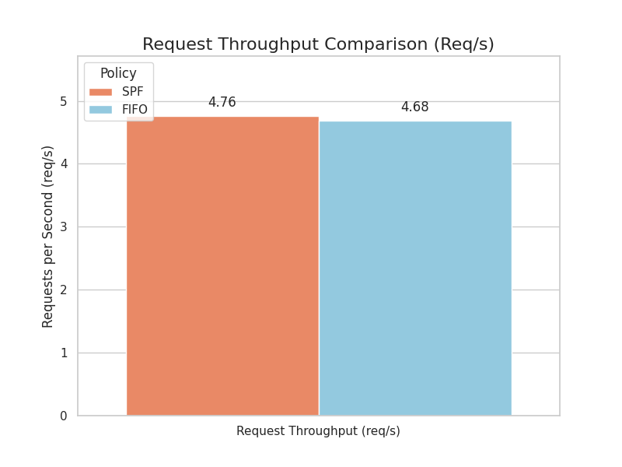
SPF vs. FIFO
meta-llama/Llama-2-7b-hf
Throughput (Req/s):
As SPF minimizes the average waiting time across all req by clearing short tasks quickly, it is able to achieve higher request throughput for the system
Notes:
As I expected, the SPF scheduler achieved a higher overall throughput, processing 4.76 requests per second compared to FIFO's 4.68. This shows that prioritizing short, easy jobs keeps the GPU busier and increases overall system efficiency.

Slide 135
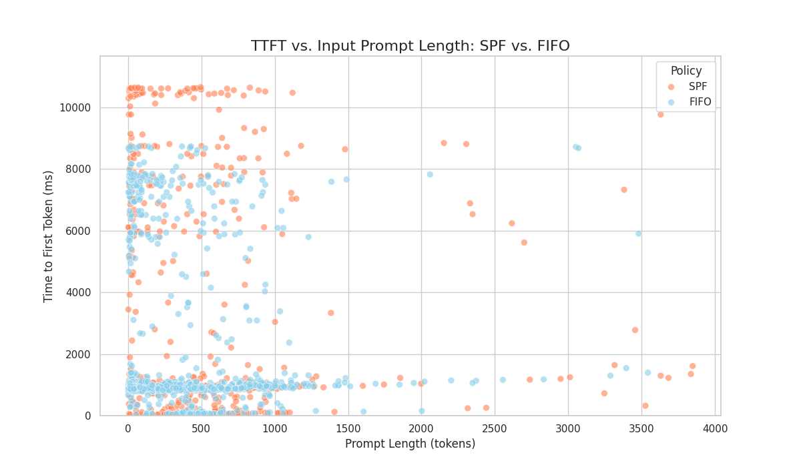
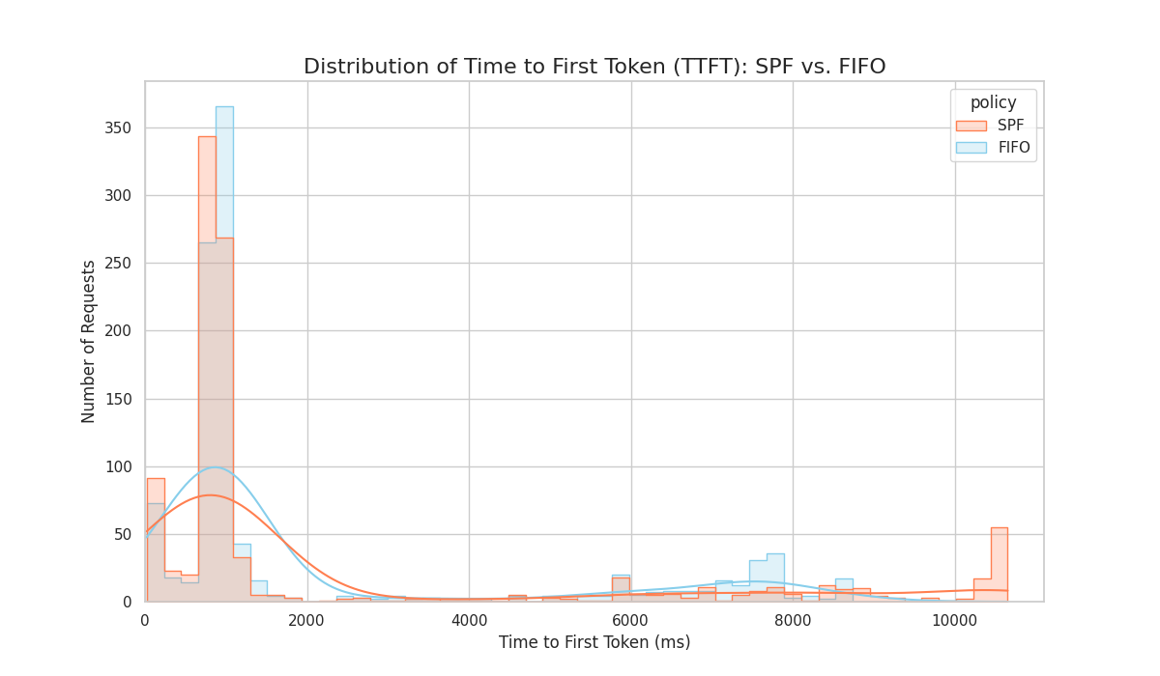
SPF vs. FIFO
meta-llama/Llama-2-7b-hf
With SPF ( Mean TTFT: 2350.43ms)
With FIFO (default)( Mean TTFT: 2122.65 ms)
P99 TTFT | 10,471 ms
Outlier Location | Heavily clustered at Short prompt lengths
Interpretation | By prioritizing shorter reqs it causes longer reqs to wait longer increasing their TTFT. Short reqs also had high TTFT because they were blocked by earlier, deprioritized long reqs.
P99 TTFT | 9,260 ms
Outlier Location | More dispersed across prompt lengths
Interpretation | As FIFO ensures fairness in queue time the policy processes strictly by arrival order. Which prevents long-term starvation seen in SPF. This keeps the worst-case queuing delay better controlled.
Notes:
However, this throughput gain came at a significant cost. For my analysis, I focused on TTFT, or Time to First Token. Which is the total delay from when a user sends a prompt to when they see the first token of the response. I'm measuring this as the entire latency because it includes both Queuing Time which is the time spent waiting for its turn, or Prefill Time which is the actual GPU compute time.
As my results show, the latency cost of SPF is severe. The P99 TTFT—which, represents the worst 1% of user experiences—was 9,260 milliseconds for FIFO. But when I switched to SPF, this P99 skyrocketed to 10,471 milliseconds, almost 10.5 seconds. This probably also dragged the Mean TTFT up significantly, to 2350ms for SPF, while FIFO's mean was much lower at 2122ms.
As you can see on the scatter plot explains why this is happening. The "Outlier Location" for SPF shows that the worst latencies were clustered at short prompt lengths. I think this is because of Starvation: even short, easy-to-process requests were getting stuck in the queue, waiting indefinitely while the SPF logic continually prioritized other short tasks that arrived later. In contrast, FIFO's simple policy of processing by arrival order prevents this long-term starvation, which is why its worst-case delay was much more controlled.

Slide 136
SPF vs. FIFO (Conclusion)
meta-llama/Llama-2-7b-hf
SPF Optimizes System Throughput at the Cost of Latency Fairness:
The Shortest Processing First policy is the throughput optimizer. By prioritizing requests with the shortest initial workload (prefill), the system maximizes resource utilization and quickly clears the queue of easy jobs..
SPF achieved a higher request throughput 4.76 req/s vs. 4.68req/s for FIFO.
SPF severely compromises user experience for the "unlucky" few. Its P99 TTFT (9,920 ms) is substantially worse than FIFO’s (9,260 ms). This is the visual signature of starvation, where high-latency requests (often long-prompt requests, or short requests stuck behind long ones) are indefinitely delayed.
SPF Optimizes System Throughput at the Cost of Latency Fairness:
The Shortest Processing First policy is the throughput optimizer. By prioritizing requests with the shortest initial workload (prefill), the system maximizes resource utilization and quickly clears the queue of easy jobs.
SPF achieved a higher request throughput 4.76 req/s vs. 4.68req/s for FIFO.
SPF severely compromises user experience for the "unlucky" few. Its P99 TTFT (9,920 ms) is substantially worse than FIFO’s (9,260 ms). This is the visual signature of starvation, where high-latency requests (often long-prompt requests, or short requests stuck behind long ones) are indefinitely delayed.
FIFO Maintains Latency Fairness and Stability:
The First-In, First-Out policy ensures a more predictable and fair waiting experience, preventing starvation.
FIFO maintained a slightly better median TTFT (886.20 ms vs 903.69ms for SPF) and a much lower TTFT. By strictly adhering to arrival order, it limits the maximum time any request can be delayed, keeping the tail latency under better control.
Trade-off(Head-of-Line Blocking): In the case where a single, long request arriving first can temporarily increase the latency for all subsequent short requests.
Notes:
This brings me to the core trade-off. My implementation of SPF proved it's a throughput optimizer. By prioritizing the shortest prefill workloads, it maximizes resource utilization and clears easy jobs, which is how I saw it achieve that higher request throughput. However, as I saw in the P99 data, this policy compromises the user experience for the "unlucky" few, creating the starvation effect, leading to that 10-second tail latency.
On the other hand, the default FIFO policy acts as a latency stabilizer. It ensures a more predictable and fair waiting experience.It had a slightly better Median TTFT (886ms vs. SPF's 904ms), meaning the typical user experience is actually better. I think this is because FIFO just processes requests as they arrive, while SPF has a small overhead from constantly sorting the queue. By sticking to its simple arrival order, FIFO limits the maximum time any request can be delayed. However FIFO's has a con which is the Head-of-Line (HoL) Blocking—where a single long request can hold up all subsequent short ones—but the benchmark shows that this is a much more controlled and predictable than the severe, indefinite starvation I saw with SPF.

Slide 137
SPF vs. FIFO (Use Case)
meta-llama/Llama-2-7b-hf
Use Case | Optimal Policy | Reason
Batch/Offline Processing | SPF | Maximizes overall job completion rate; individual latency is less critical.
Interactive Chatbots/Agents | FIFO | Minimizes the chance of extreme latency outliers and provides a fairer, more stable experience across all users.
What I changed in the code:
Instead of using vllm.entrypoints.cli.main i used threading request and random to
Simulate 200 concurrent users based on a possession arrival process,
Use the benchmark_worker function to run on multiple threads, to generate concurrent load.
Notes:
In conclusion, SPF is a good policy if your only goal is maximizing overall job completion rate, making it suitable for Batch or Offline Processing where individual latency is not critical. However, for any interactive application like a chatbot, FIFO is the superior choice. It provides a more stable and fair experience for all users by minimizing the chance of extreme latency outliers.
So what I did is,I modified the vLLM scheduler directly in the scheduler.py file to sort the waiting queue by prompt length, implementing the SPF policy. I then benchmarked both SPF and FIFO using a client script simulating 200 concurrent users sending a total of 1024 requests.

Slide 138
Next Step
Run the VQA workflow with vLLM

Slide 139
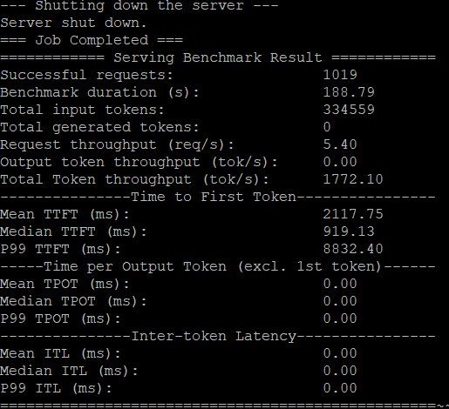
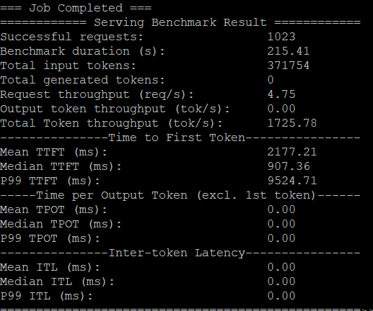
SPF vs. FIFO
meta-llama/Llama-2-7b-hf
With SPF (cat SPF.o12054748)
With FIFO (default) (cat FIFO.o12054930)
With SPF it processes 5.40 requests/second which is 14% higher than FIFO’s 4.75 req/s
FIFO has a slightly better median TTFT (907ms vs 919ms). This is because FIFO immediately serves the newest request that just arrived.
The P99 TTFT shows that in FIFO, the slowest 1% of requests took over 9.5 seconds to get a response, while SPF took 8.8 seconds. I suspect this is due to Head-of-Line(HoL) blocking, With FIFO, if a short, easy request gets stuck in the queue behind a very long, slow request, it simply has to wait. SPF avoids this by allowing the short request to "jump the line," which significantly improves the worst-case wait time.
FIFO has a better median, this is probably because SPF has a small overhead where it has to sort the waiting requests to find the shortest one.

Slide 140
Plans-02/10/2025
TODO
Read the paper of vLLM^{[1]}
Conduct a small experiment with vLLM using NSCC cluster
Understand the workflow details of vLLM
Modify the scheduling policies in vLLM
Read the paper of Agent Workflow^{[2]}
Run the video & Q/A application with vLLM
[1] https://arxiv.org/abs/2309.06180
[2] https://arxiv.org/abs/2508.18298

Slide 141
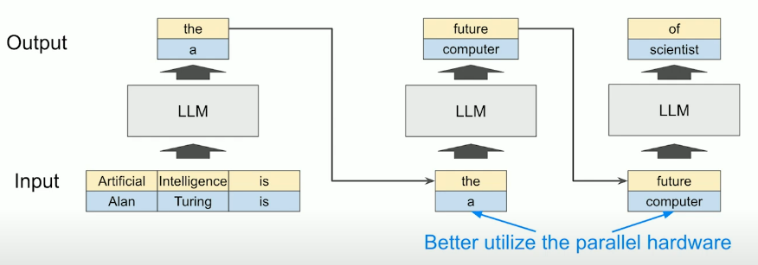
Efficient Memory Management for Large Language Model Serving with PagedAttention
ACM SIGOPS. (2024, October 12). SOSP '23 | Efficient Memory Management for Large Language Model Serving with PagedAttention. YouTube. https://www.youtube.com/watch?v=UdNocRPQS3Y
The Problem:
Serving LLMs is surprisingly slow and expensive $$$. Microsoft has even struggled to secure GPUs for its service.
Low GPU Utilization
LLMs generate one token at a time (autoregressively). The token is dependent on the previous one. Which is difficult to parallelize as it cant be executed simultaneously.
Because of this sequential nature the workload becomes memory-bound rather than compute-bound. This means the GPU spends more time waiting for data to be loaded from memory than on performing calculations, leading to wasted computational resources.
Solution Batching -> New problem KV Cache is limited by the amount of GPU mem available

Slide 142
Efficient Memory Management for Large Language Model Serving with PagedAttention
96% memory utilization
2-4x higher throughput
The KV Mem Massive Memory Waste:
When an LLM generates a new token, it reuses the computations from all previous tokens in the sequence. This is hard to manage because it is huge and dynamic! Previously they used pre-allocated continuous bock of memory for each request, sized for max possible len (e.g 2048).
Internal Fragmentation
- A request rarely uses its fully allocated length
External Fragmentation
- The memory allocator struggles to fit new requests of varying sizes into the gaps left by the completed ones.
Only 20 to 40% of the allocated KV cache mem is actually used :0
The solution Paged Attention (Applying Virtual Memory to the KV Cache:
The KV Cache is divided into fixed-sized blocks, like memory pages in an OS.
↓
Each request’s KV Cache is stored in non-contiguous physical blocks on the GPU
↓
A block table maps a request’s logical blocks to physical blocks, just like an OS page table.
vLLM is built on paged attention and puts these concepts to actual use.

Slide 143
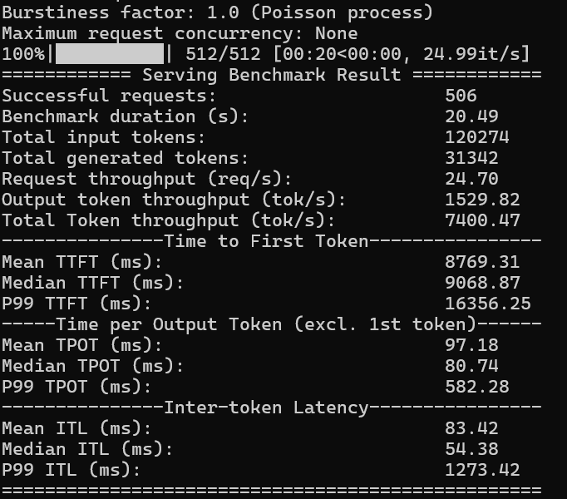
Benchmarking vLLM using NSCC Cluster
TinyLlama/TinyLlama-1.1B-Chat-v1.0
Summary
In a nutshell, the system is highly performant in terms of raw processing speed, as shown by the high request and token throughputs. However, it suffers from a significant "cold start" issue, as indicated by the very high Time to First Token (TTFT). This means that while the model generates its response quickly once it gets started, there's a long initial delay before the first part of the answer appears.
Possible reasons for the High TTFT
The model being loaded into GPU memory on the first request.
The batching and scheduling system (vLLM) taking time to process the initial queue of requests.
The high P99 TTFT value suggests that this initial delay is not consistent and some requests experienced much worse latencies than the average.

Slide 144
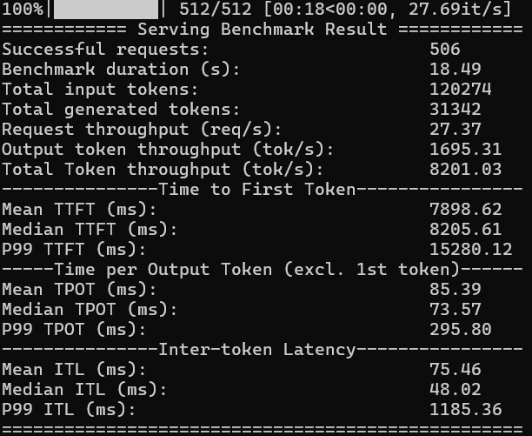
Benchmarking vLLM using NSCC Cluster
meta-llama/Llama-2-7b-hf
Summary
In a nutshell, the system is highly performant in terms of raw processing speed, as shown by the high request and token throughputs. However, it suffers from a significant "cold start" issue, as indicated by the very high Time to First Token (TTFT). This means that while the model generates its response quickly once it gets started, there's a long initial delay before the first part of the answer appears.
Possible reasons for the High TTFT
The model being loaded into GPU memory on the first request.
The batching and scheduling system (vLLM) taking time to process the initial queue of requests.
The high P99 TTFT value suggests that this initial delay is not consistent and some requests experienced much worse latencies than the average.

Slide 145
The Workflow details of vLLM
System Architecture and Control Flow:
vLLM is a high-throughput distributed LLM serving engine. It is implemented based on PyTorch and Hugging Face Transformers, utilizing Ray and Megatron-LM for distributed execution
Centralized Engine
- A centralized engine manages the block table and acts as the Scheduler. It broadcasts control messages containing input token IDs and block tables to GPU workers at the start of each decoding iteration
GPU Workers
- GPU workers execute the model distributedly (model parallel fashion). Each worker contains a Cache Engine that allocates physical blocks according to memory commands received from the centralized engine
PagedAttention & KV Cache Management:
KV Cache Partitioning
PagedAttention partitions the KV cache (attention keys and values) of each sequence into fixed-size KV blocks (analogous to pages in an OS.)
Memory Mapping
The KV Cache Manager maintains block tables that map a request's logical KV blocks (consecutive view) to non-contiguous physical KV blocks (on GPU DRAM). This design allows vLLM to utilize over 96% of the KV cache space on average
Dynamic Allocation
Memory is allocated on demand. A new physical block is allocated only when the last block of a sequence is full

Slide 146
The Workflow details of vLLM
Decoding and Advanced Features:
Decoding Steps
For each decoding iteration, vLLM first selects candidate sequences for batching and allocates physical blocks for newly required logical blocks. The LLM computes the next token, using the PagedAttention kernel to fetch necessary KV blocks via the block table.
KV Cache Sharing
PagedAttention enables flexible memory sharing within and across requests, crucial for complex decoding algorithms. For scenarios like parallel sampling or beam search, prompt blocks can be shared
Copy-on-Write (CoW)
If a shared physical block needs modification (e.g., writing a newly generated token), the CoW technique is used: a new physical block is allocated, the old content is copied, and the sequence writes to the new, unique block.
Scheduling and Recovery:
Scheduling Policy
vLLM uses a First-Come-First-Serve (FCFS) scheduling policy to ensure fairness and prevent starvation.
Preemption Policy
When the system runs out of physical blocks, it employs an all-or-nothing eviction policy, preempting the entire request (or sequence group). The latest arrived requests are preempted first.
Recovery Mechanisms
o recover evicted blocks, vLLM uses two methods: Swapping (copying GPU KV blocks to larger CPU RAM, managed by a CPU block allocator) or Recomputation (deleting the KV cache and regenerating it later).

Slide 147
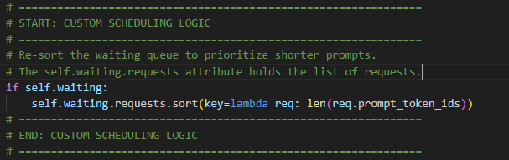
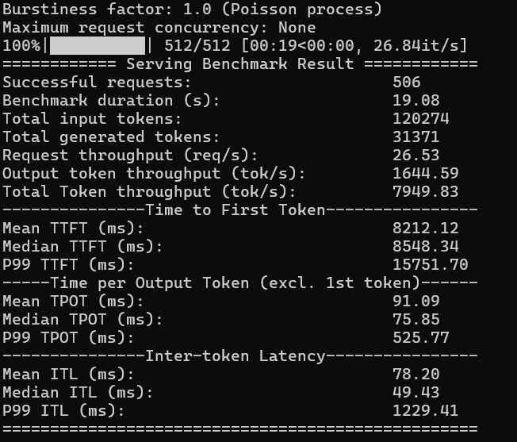
Modify Scheduling Policies
meta-llama/Llama-2-7b-hf
Objective :
Replace FCFS to prioritize shorter prompts.
Changed in vllm/v1/core/sched/scheduler.py file
In schedule(self) -> SchedulerOutput:
Added Shortest Prompt First Policy
Results :
FCFS performed better (original)

Slide 148
Murakkab: Resource-Efficient Orchestration for Agentic AI Workflows
GPU Usage Up to 2.8x Reduction
Energy Consumption Up to 3.7x Reduction
Cost Up to 4.3x reduction
The Problem:
Today's agentic workflows, which combine multiple AI models and tools, are inefficiently served in the cloud. Leading to wasted resources and high costs.
Fragmentation
- Workflows are spread across different frameworks, providers, and cloud platforms with minimal coordination
Tight Coupling
- Application logic is hard-coded with specific models and hardware
The solution Murakkab:
Murakkab automates the optimisation of multi-tenant agentic workflows. It manages the entire workflow life-cycle from development to execution.
Declarative Specification which is like telling the system what(the application logic) you want, rather than how(the technical details) to do it.
(No need to specify which AI model to use (like "Llama-3.2"), how many GPUs to reserve, or which cloud provider to use ).
Profile-Guided Optimisation & Adaptive Runtime
(Murakkab studies different AI models and hardware setups in advance to see how they perform. It creates detailed reports (profiles). It constantly monitors the workload and resource availability. It's able to reconfigure workflows, share resources and auto-scale.).

